Slide 1
Multimodal AutoML for
Image, Text and Tabular Data
Nick Erickson, Senior Software Engineer, AWS AI

Slide 2

The AutoML Revolution
Presenter: Nick Erickson
Senior Software Engineer & AutoGluon Co-author, AWS

Slide 3





ML in a Nutshell
Images
Text
Tabular
1. Bring Data
2. Train Models
3. Make Predictions

Slide 4
7 Steps to an AutoML Revolution
Easy to use & widely available
Strong Performance
Fast Inference Speed
Stable & Reliable
Customizable
Interpretable
Deployable

Slide 5
AutoGluon Overview
AutoGluon is an AutoML Toolkit that democratizes machine learning
Automatically builds accurate models for Image, Text, and Tabular data with a single line of code
Open source & easy to customize
pip install autogluon

Slide 6
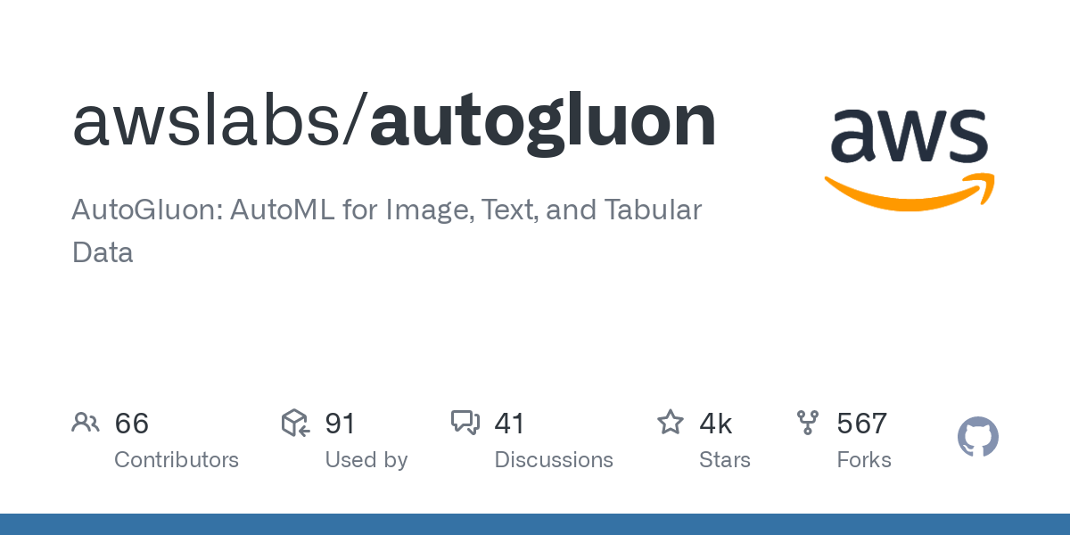



AutoGluon Overview
auto.gluon.ai

Slide 7
AutoGluon and AutoML
Prior work: AutoML == Model + Hyperparameter Selection (CASH)
AutoGluon: Rely on strategies that win prediction contests
Thoughtful data preprocessing
Model ensembling via multi-layer stacking
Greater emphasis on modern deep learning techniques
Boatloads of tricks and optimizations

Slide 8
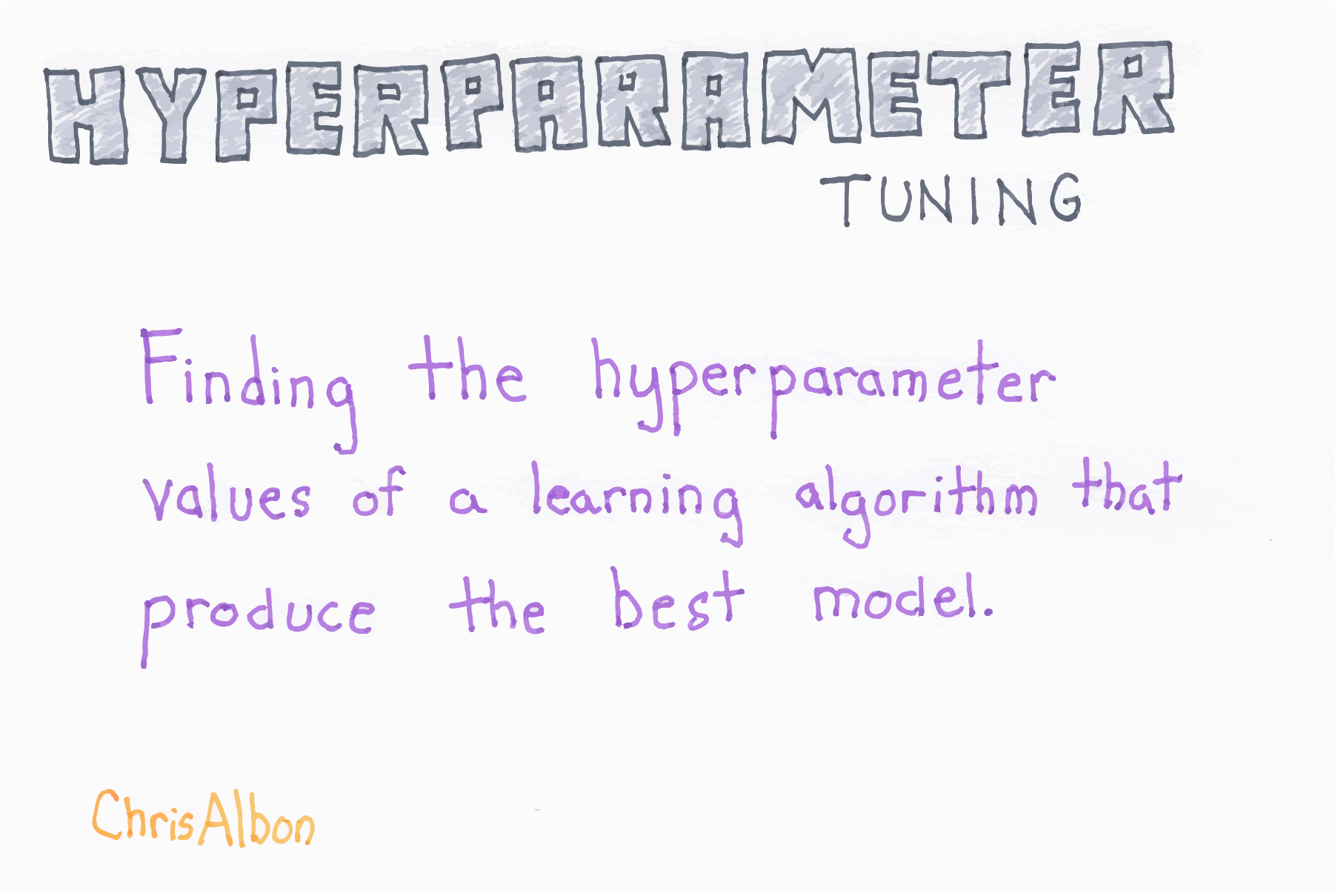
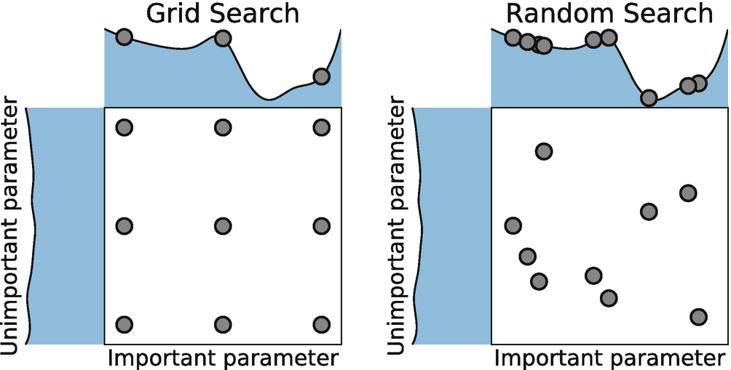
Hyperparameter Tuning Benefits
Image Courtesy - https://machinelearningflashcards.com/

Slide 9
Hyperparameter Tuning Drawbacks
Requires many repeated model trainings
Most of the models being trained are thrown away and don’t contribute to the final result
The more hyperparameter tuning done, the more the final model is overfit on the validation data
Less helpful when ensembling

Slide 10
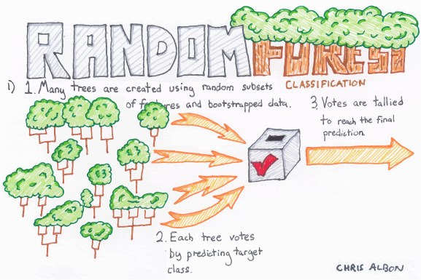
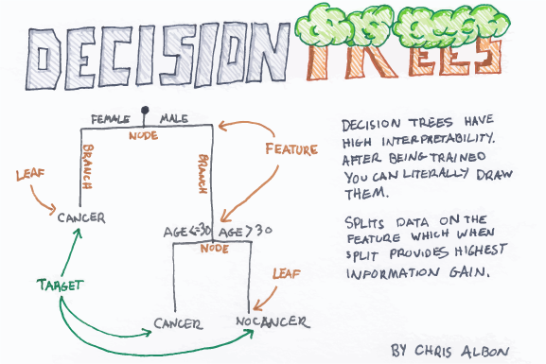
Introduction to Ensembles: Random Forest
Image Courtesy - https://machinelearningflashcards.com/

Slide 11
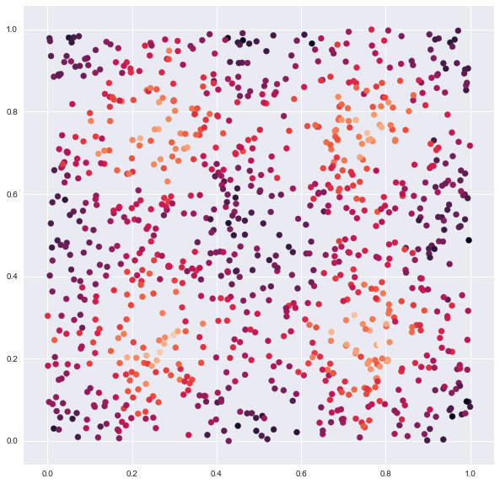
Ensembling: The Data
Image Courtesy - https://gist.github.com/tylerwx51/fc8b316337833c877785222d463a45b0

Slide 12
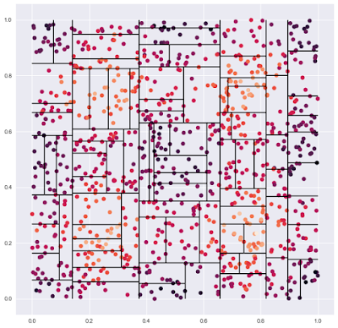
Ensembling: A Decision Tree
Image Courtesy - https://gist.github.com/tylerwx51/fc8b316337833c877785222d463a45b0

Slide 13
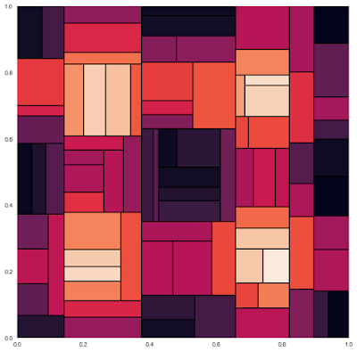
Ensembling: A Decision Tree
Image Courtesy - https://gist.github.com/tylerwx51/fc8b316337833c877785222d463a45b0

Slide 14
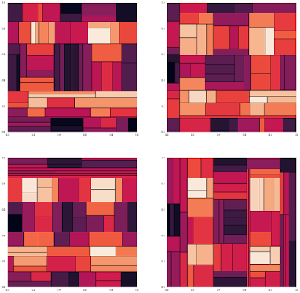
Ensembling: Many Decision Trees
Image Courtesy - https://gist.github.com/tylerwx51/fc8b316337833c877785222d463a45b0

Slide 15
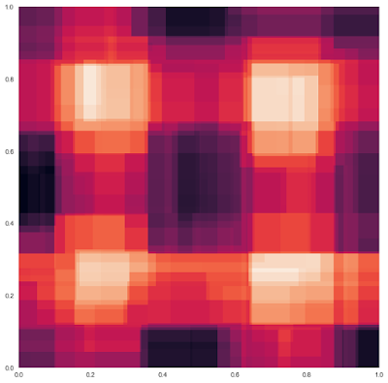
Ensembling: A Random Forest
Image Courtesy - https://gist.github.com/tylerwx51/fc8b316337833c877785222d463a45b0

Slide 16
Ensembling: A Random Forest
Image Courtesy - https://gist.github.com/tylerwx51/fc8b316337833c877785222d463a45b0

Slide 17
Ensembling: Takeaways
Many are better than few
Models that learn differently can boost accuracy even if they are worse in isolation
Hyperparameter tuning to find the best single model does not necessarily help find the best combination of models

Slide 18
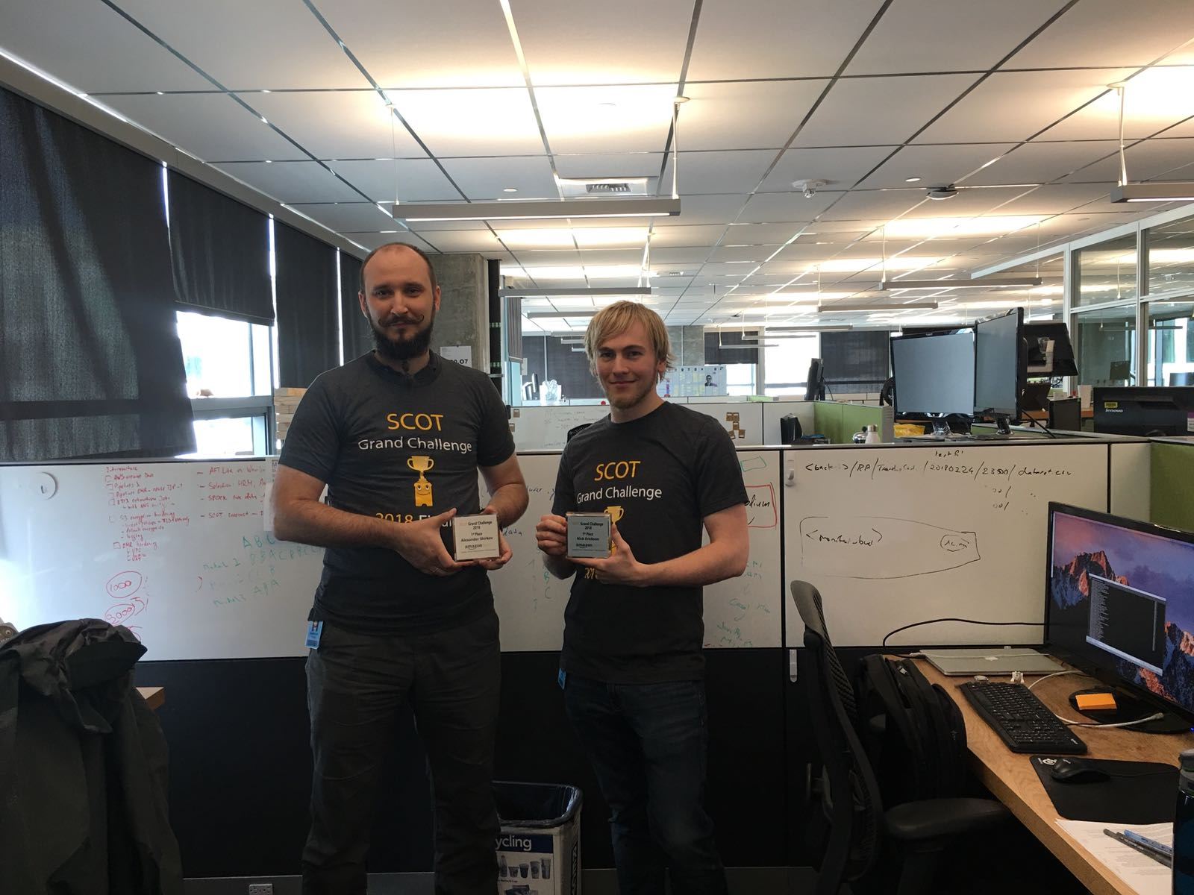
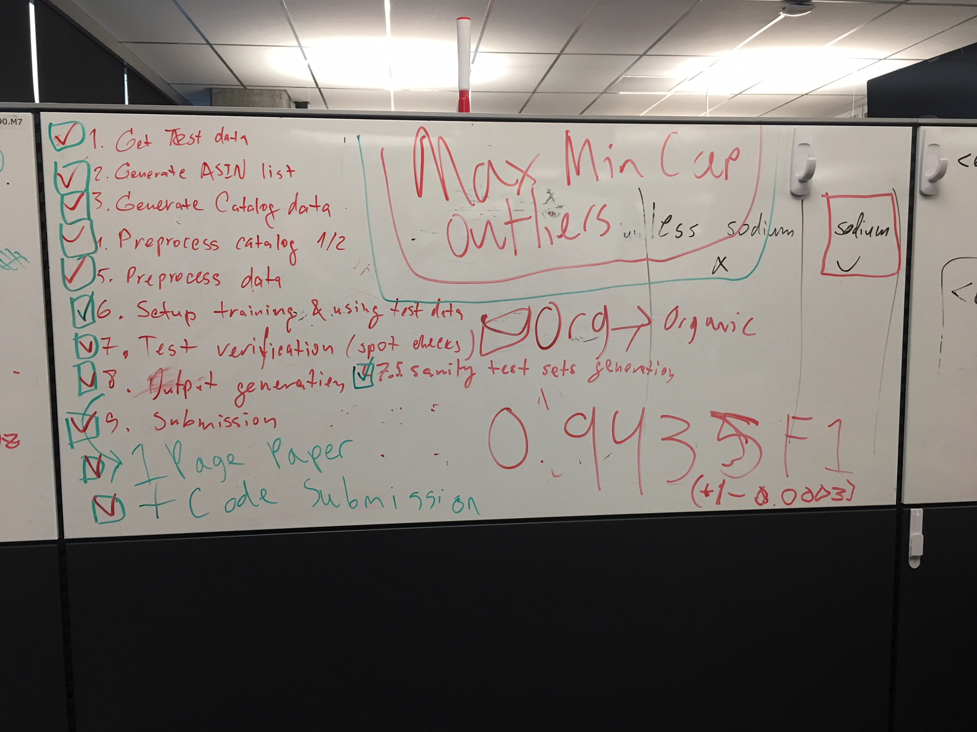

Origins of AutoGluon
SCOT Grand Challenge 2018
Alex Shirkov & Nick Erickson

Slide 19
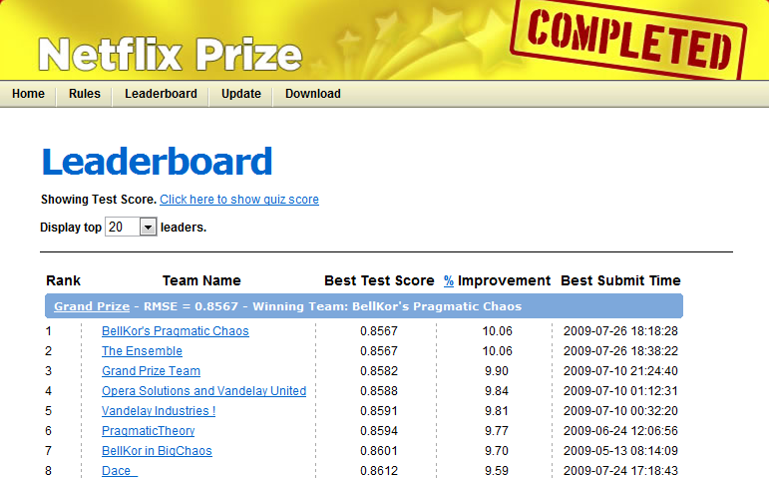
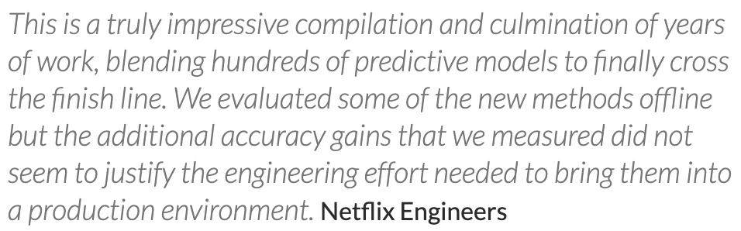
The Netflix Prize: Creating Monsters

Slide 20
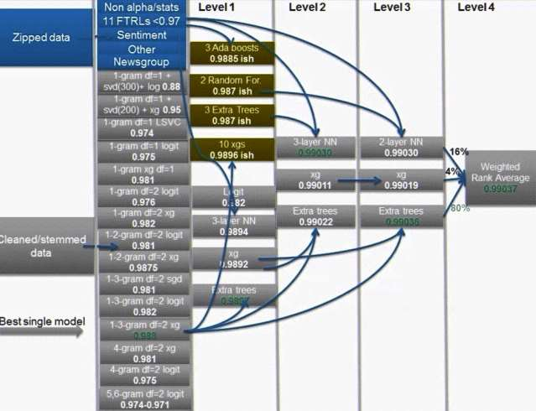
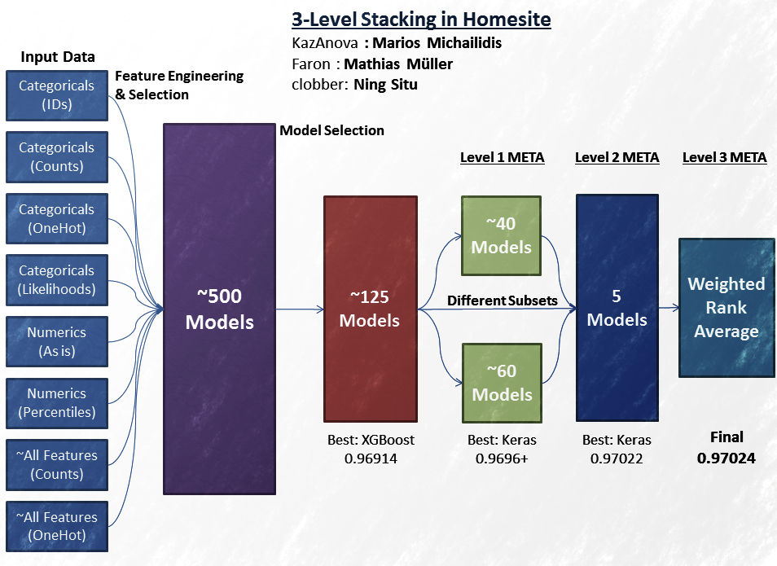
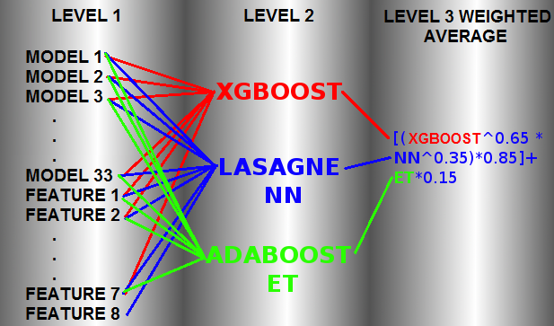
The Evolution of Monsters

Slide 21
Can we tame the monsters?
Can we:
Make them reliably performant, stable, and sensible to countless different datasets?
Assemble them in an appropriate manner without need for expert knowledge from the user?
Train them in a reasonable amount of time, on a wide variety of hardware?
Enable flexibility to satisfy user constraints?
Hide complexity behind an elegant API?
AutoGluon strives to achieve these goals

Slide 22
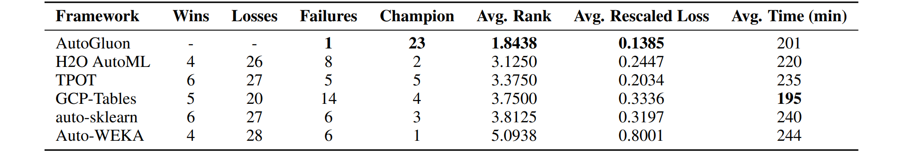
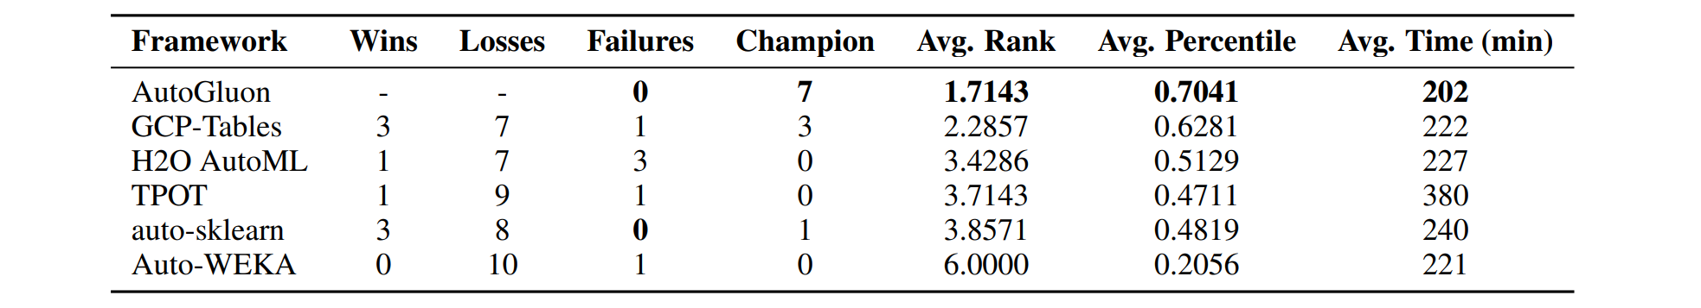
2020 Pairwise Comparisons: AutoML & Kaggle Benchmarks
Table 1: AutoML Benchmark (39 datasets)
Table 2: Kaggle Benchmark (11 datasets)
Reference: AutoGluon-Tabular: Robust and Accurate AutoML for Structured Data. Arxiv, 2020

Slide 23
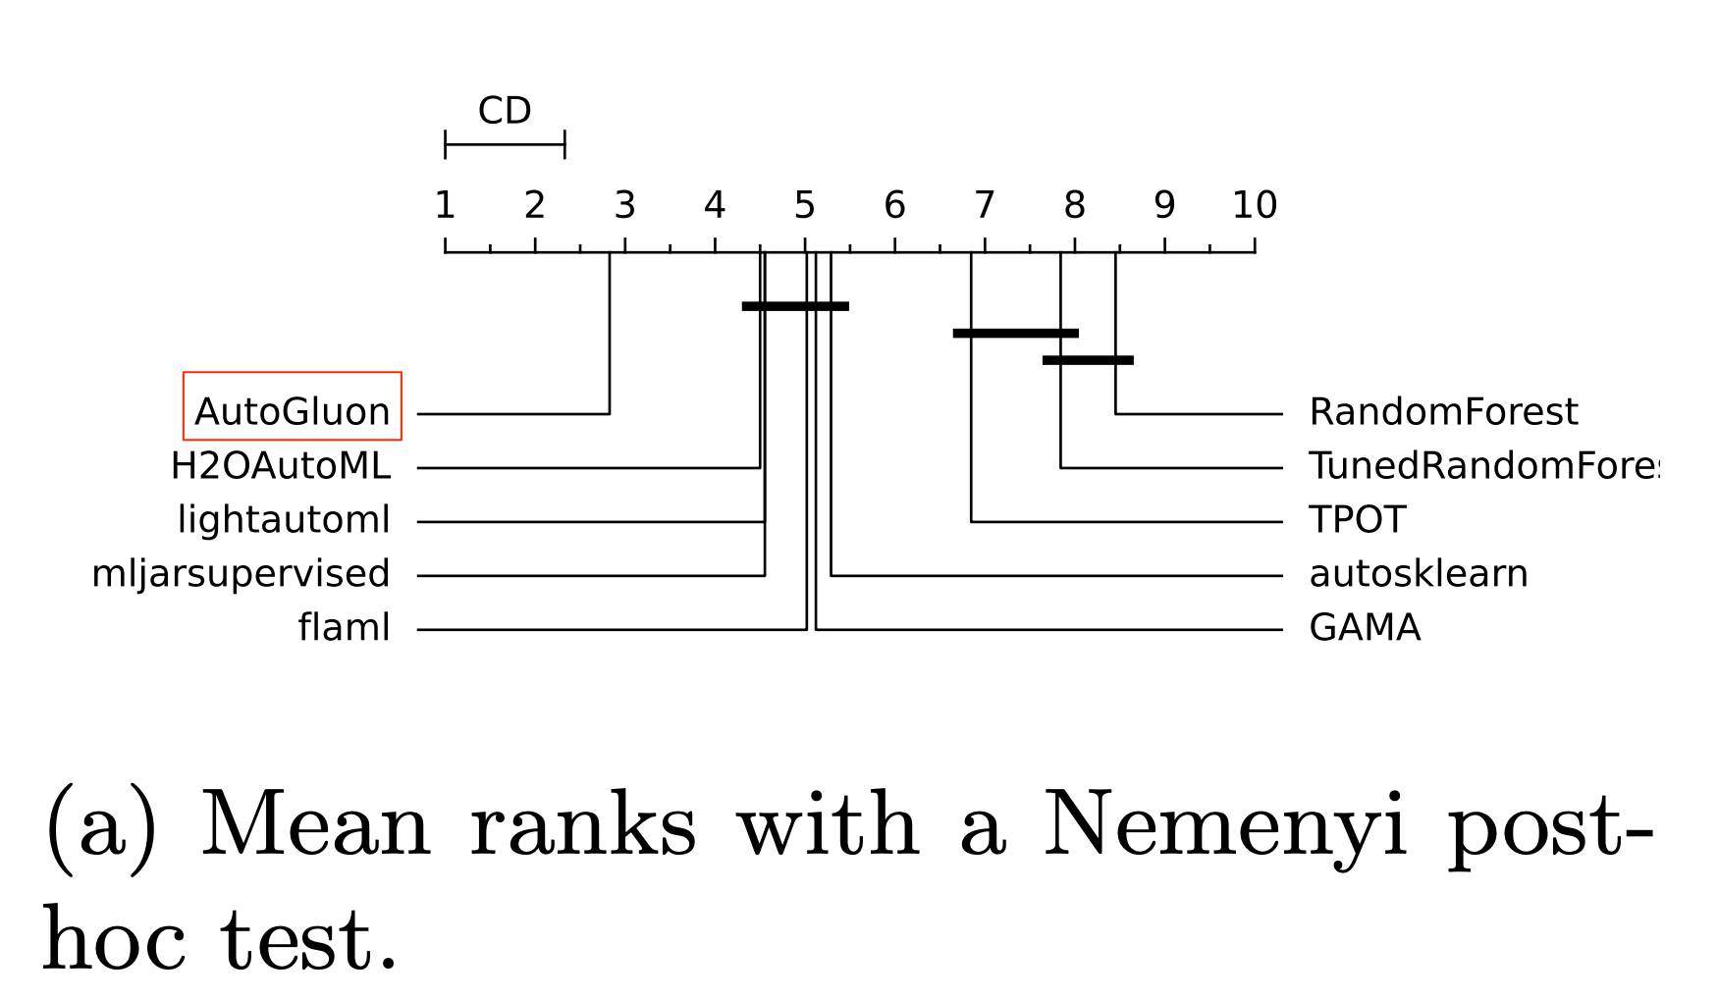
2022 AutoMLBenchmark (104 datasets, 10-fold, 4 hours)
Reference: Gijsbers, Pieter. “Systems for AutoML Research.” Arxiv, 2022.

Slide 24
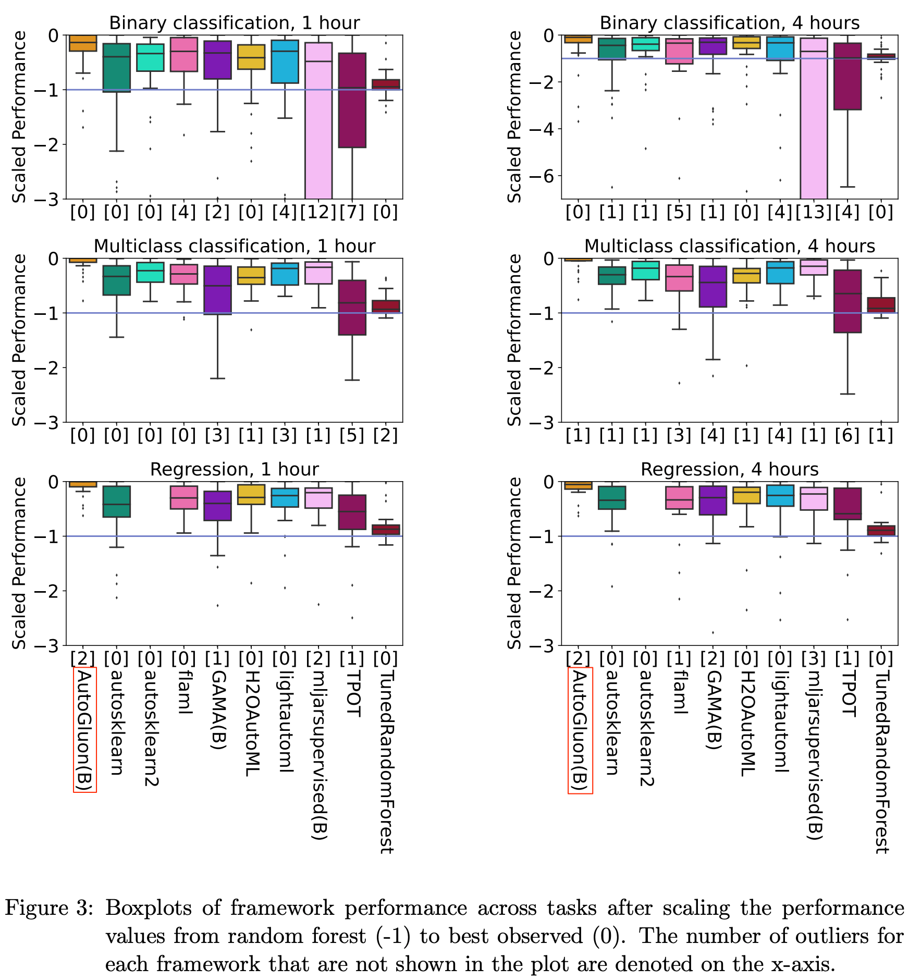
2022 AutoMLBenchmark (104 datasets, 10-fold)
Reference: Gijsbers, Pieter, et al. “AMLB: an AutoML Benchmark.” Arxiv, 2022.

Slide 25
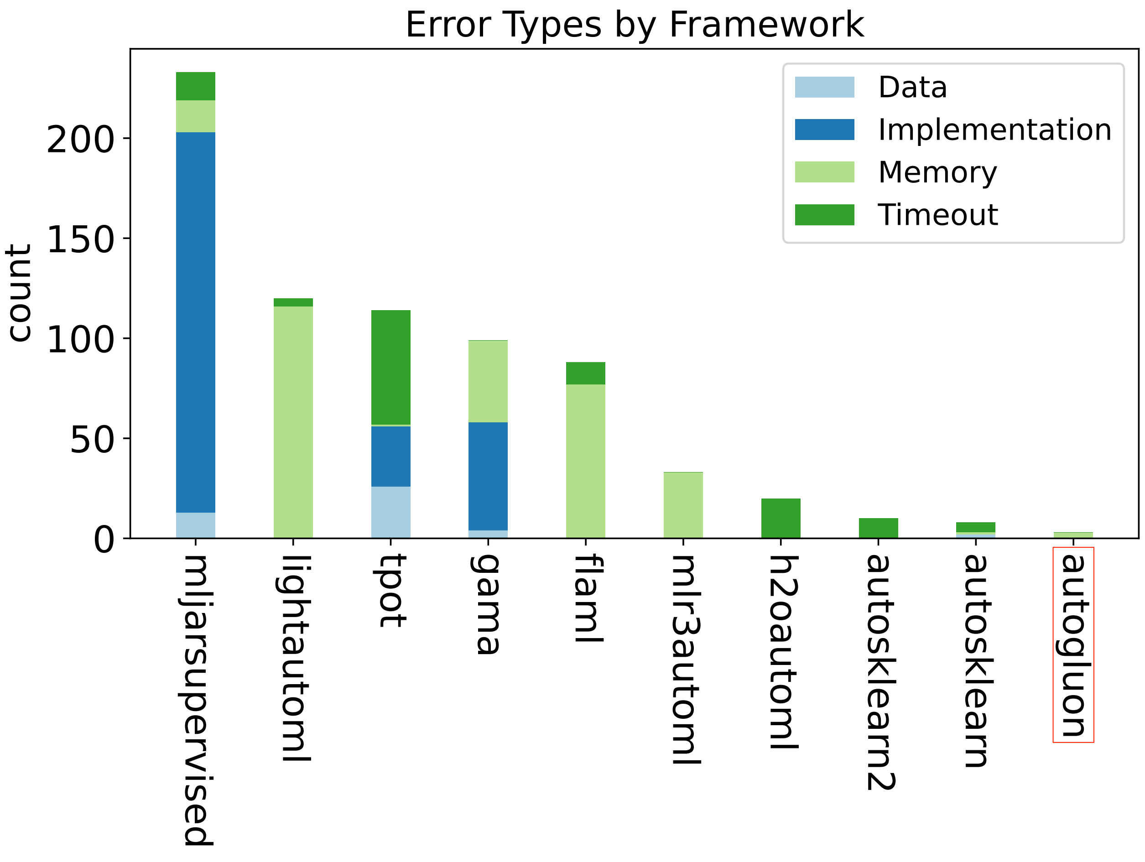
AutoML Stability & Robustness: AutoGluon has a 99.86% success rate (3 failures in 2080 datasets)
Reference: Gijsbers, Pieter, et al. “AMLB: an AutoML Benchmark.” Arxiv, 2022.

Slide 26
Enabling control of inference speed via infer_limit
A common concern with AutoML:
Will it be slow to infer?
How can I control the inference speed?
New in AutoGluon v0.4:
`infer_limit`
`infer_limit_batch_size`
AutoGluon will automatically adapt its training and ensembling strategy to satisfy the constraint.
Ideal for meeting online inference latency requirements and for large-scale batch inference workloads.

Slide 27
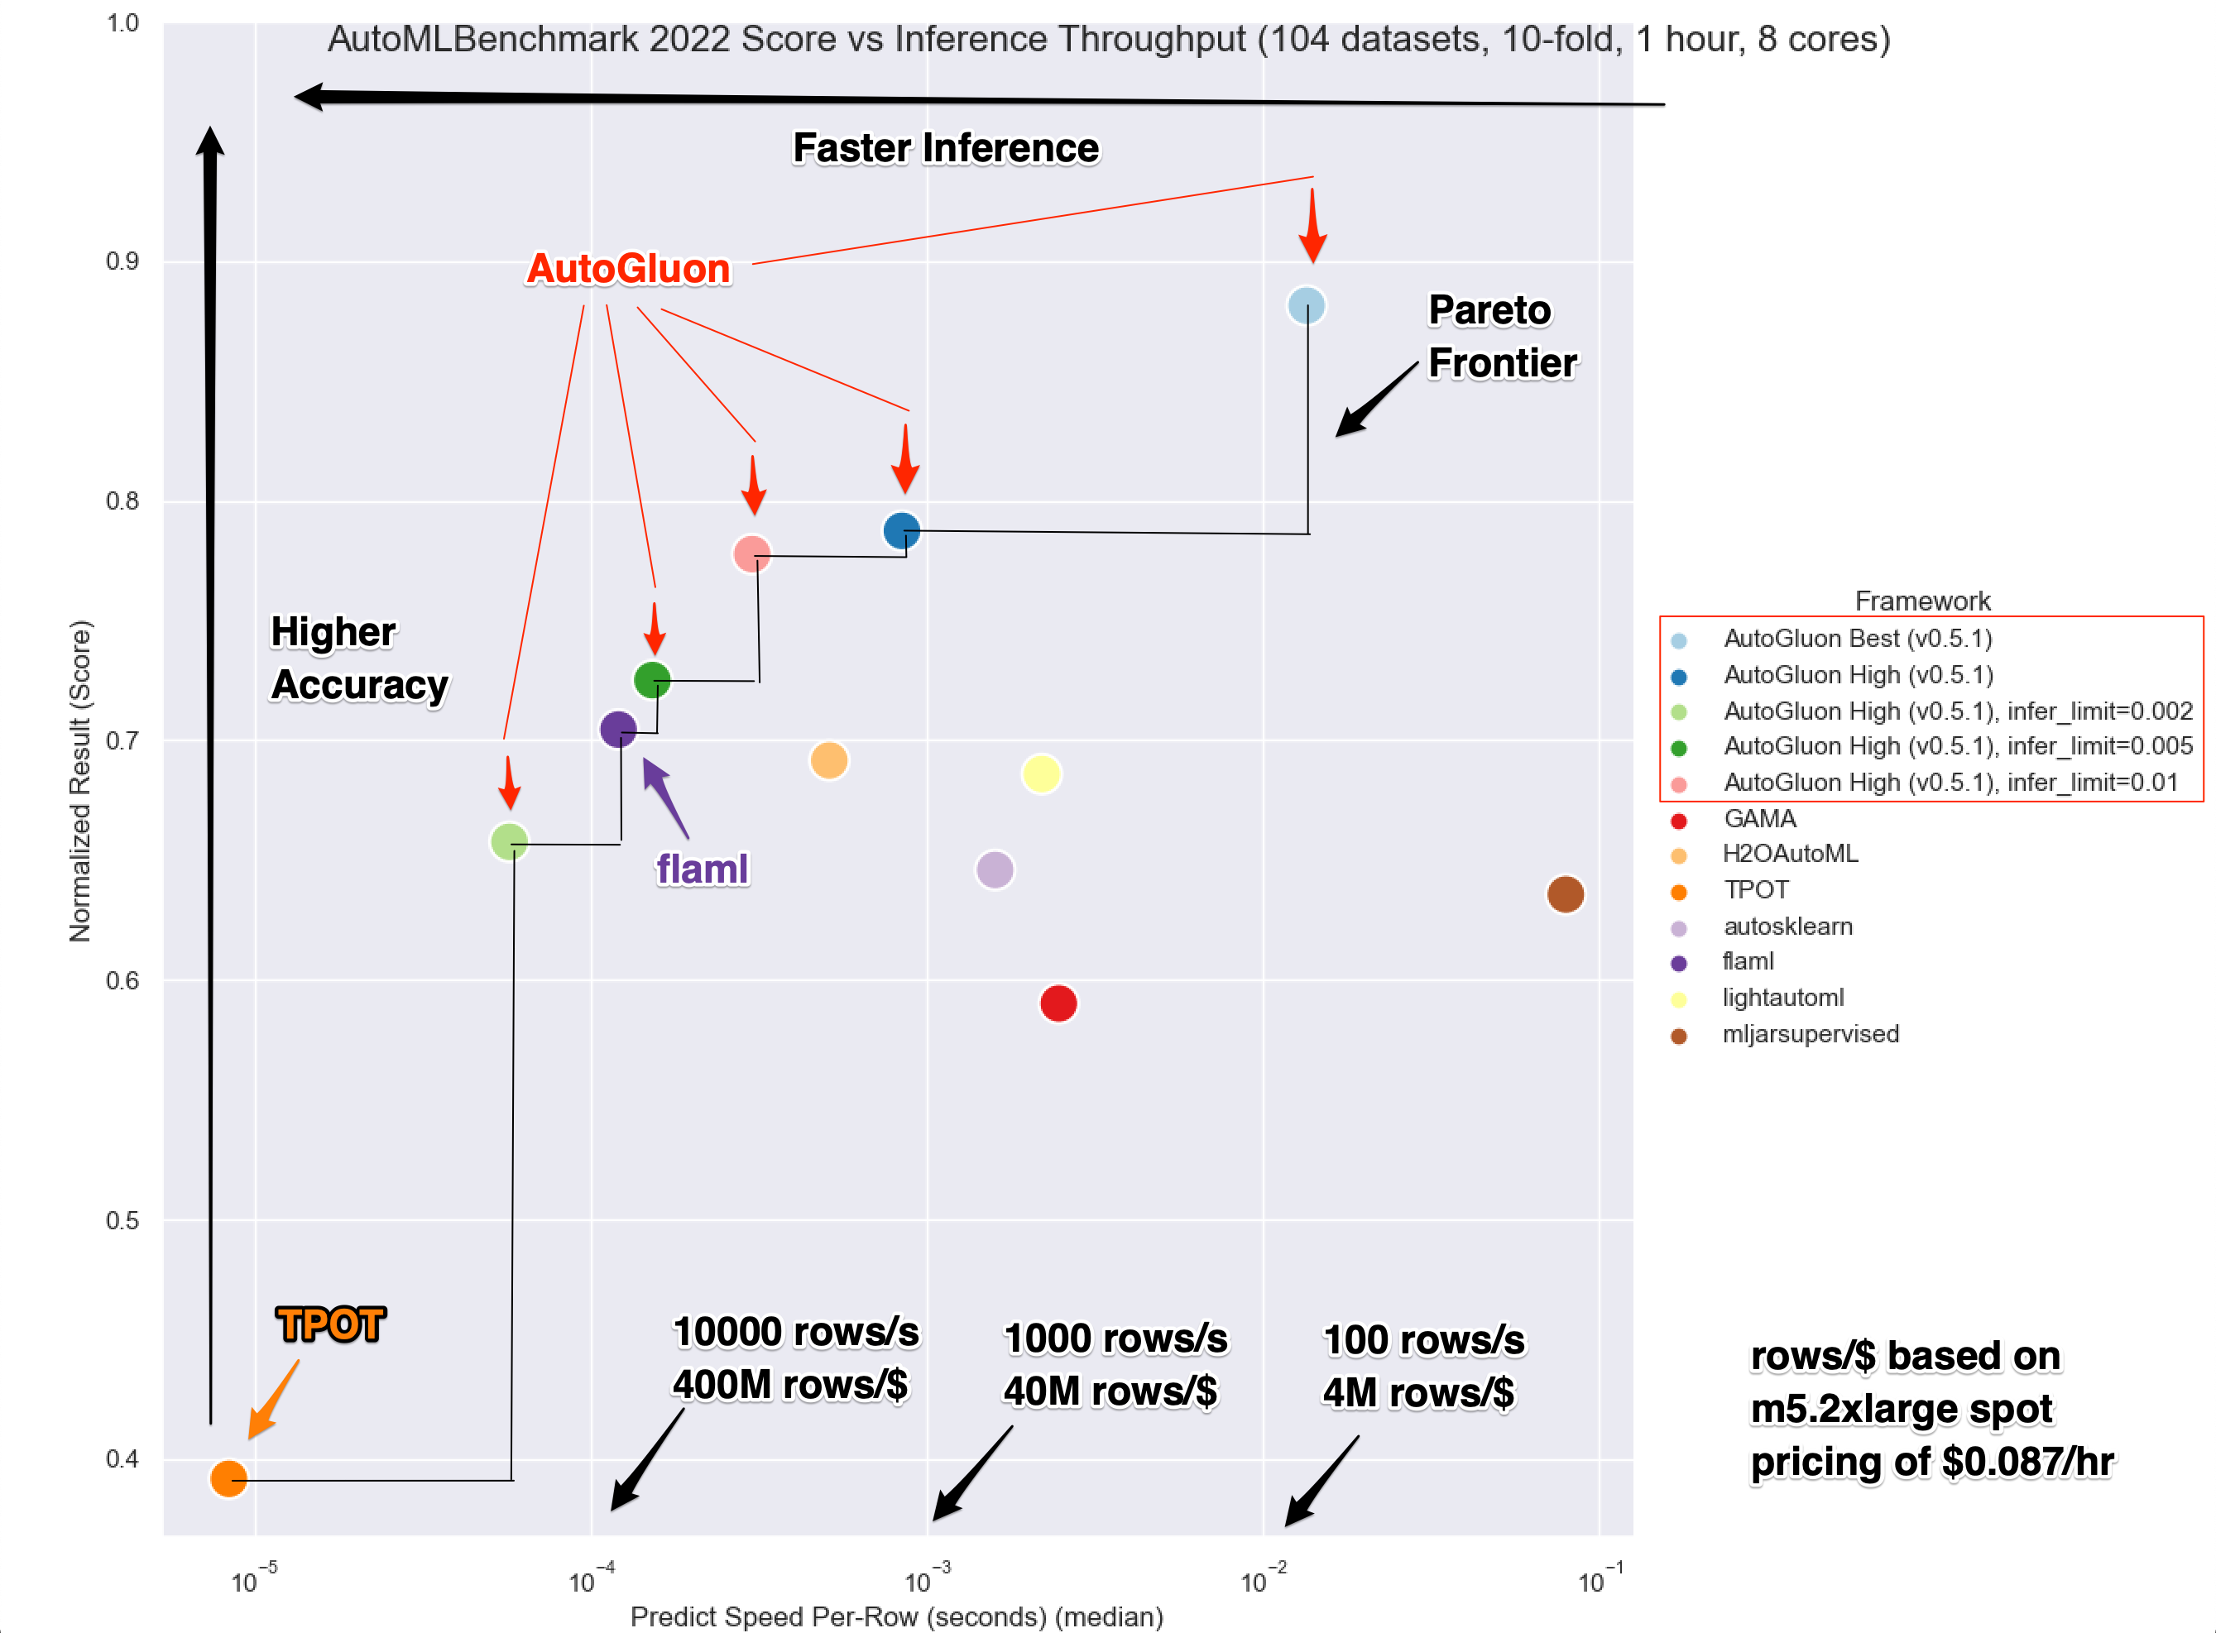
AutoML Tradeoffs Between Quality and Inference Speed
Results for AutoGluon based on mainline AutoMLBenchmark: https://github.com/openml/automlbenchmark/
Results for other frameworks from Gijsbers, Pieter, et al. “AMLB: an AutoML Benchmark.” Arxiv, 2022.

Slide 28
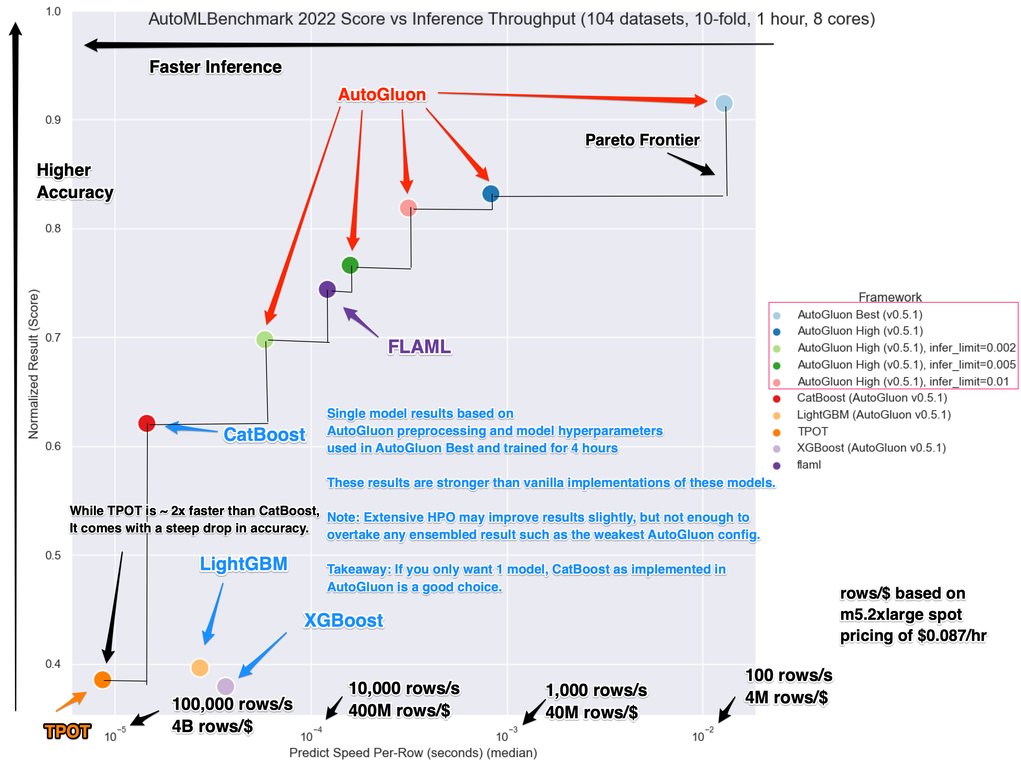
AutoML Compared to Strong Single Models

Slide 29
AutoGluon Competition Results
Kaggle
(2018) 2nd out of 2742 (Mercari Price Suggestion)
(2021) 2nd out of 172 (California House Prices)
(2015) 14th out of 3507 (Otto Group Product Classification)
(2022) 20th out of 3537 (PetFinder Pawpularity Contest)
(2016) 28th out of 2920 (BNP Parabis)
MachineHack
(2020) 1st out of 1544 (Predict Data Scientist Salary)
(2021) 1st out of 314 (Product Sentiment Classification)
(2021) 2nd out of 3922 (Predict the Price of Books)

Slide 30
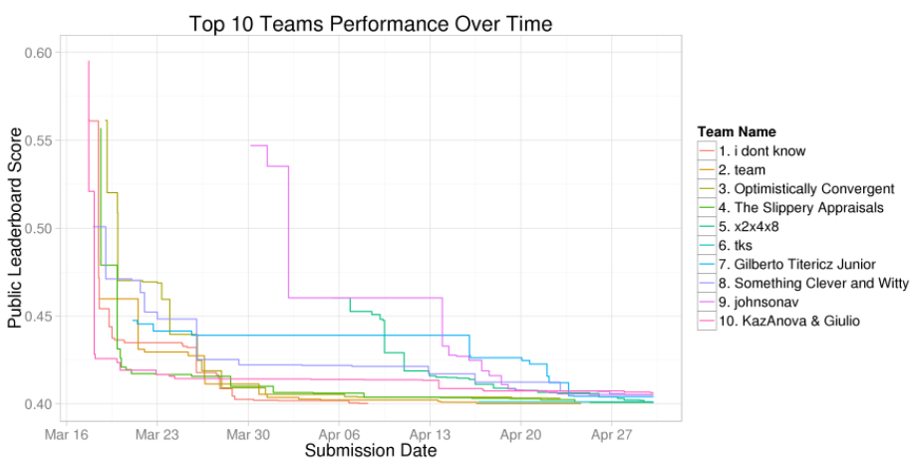
Otto-Group: AG-Tabular v0.4 after 4 hours (0.399)
This competition (Otto) had over 3500 teams compete.
In 4 hours AG achieved a score that took the best human team over 2 months to beat on Kaggle.
This solution placed Rank 14 on the final private leaderboard: Kaggle Gold.
AG v0.4 4h score (0.399)

Slide 31
AutoGluon and AutoML
To obtain those results:
AutoGluon did not hyperparameter tune
AutoGluon used the same hyperparameters for every problem
AutoGluon used near default hyperparameters for all of its models
AutoGluon trained using the same 3 lines of code for every problem

Slide 32
AutoGluon Model Variety
AutoGluon has a large number of models implemented and optimized out of the box:
Powerful Gradient Boosting Models
XGBoost, LightGBM, CatBoost
Custom Tabular Neural Networks
sklearn Random Forest, Extra Trees, KNN
SOTA Image Models: EfficientNet, ResNet, etc.
Any TIMM Compatible Model
SOTA Text Models: BERT, Electra, etc.
Any HuggingFace Compatible Model

Slide 33
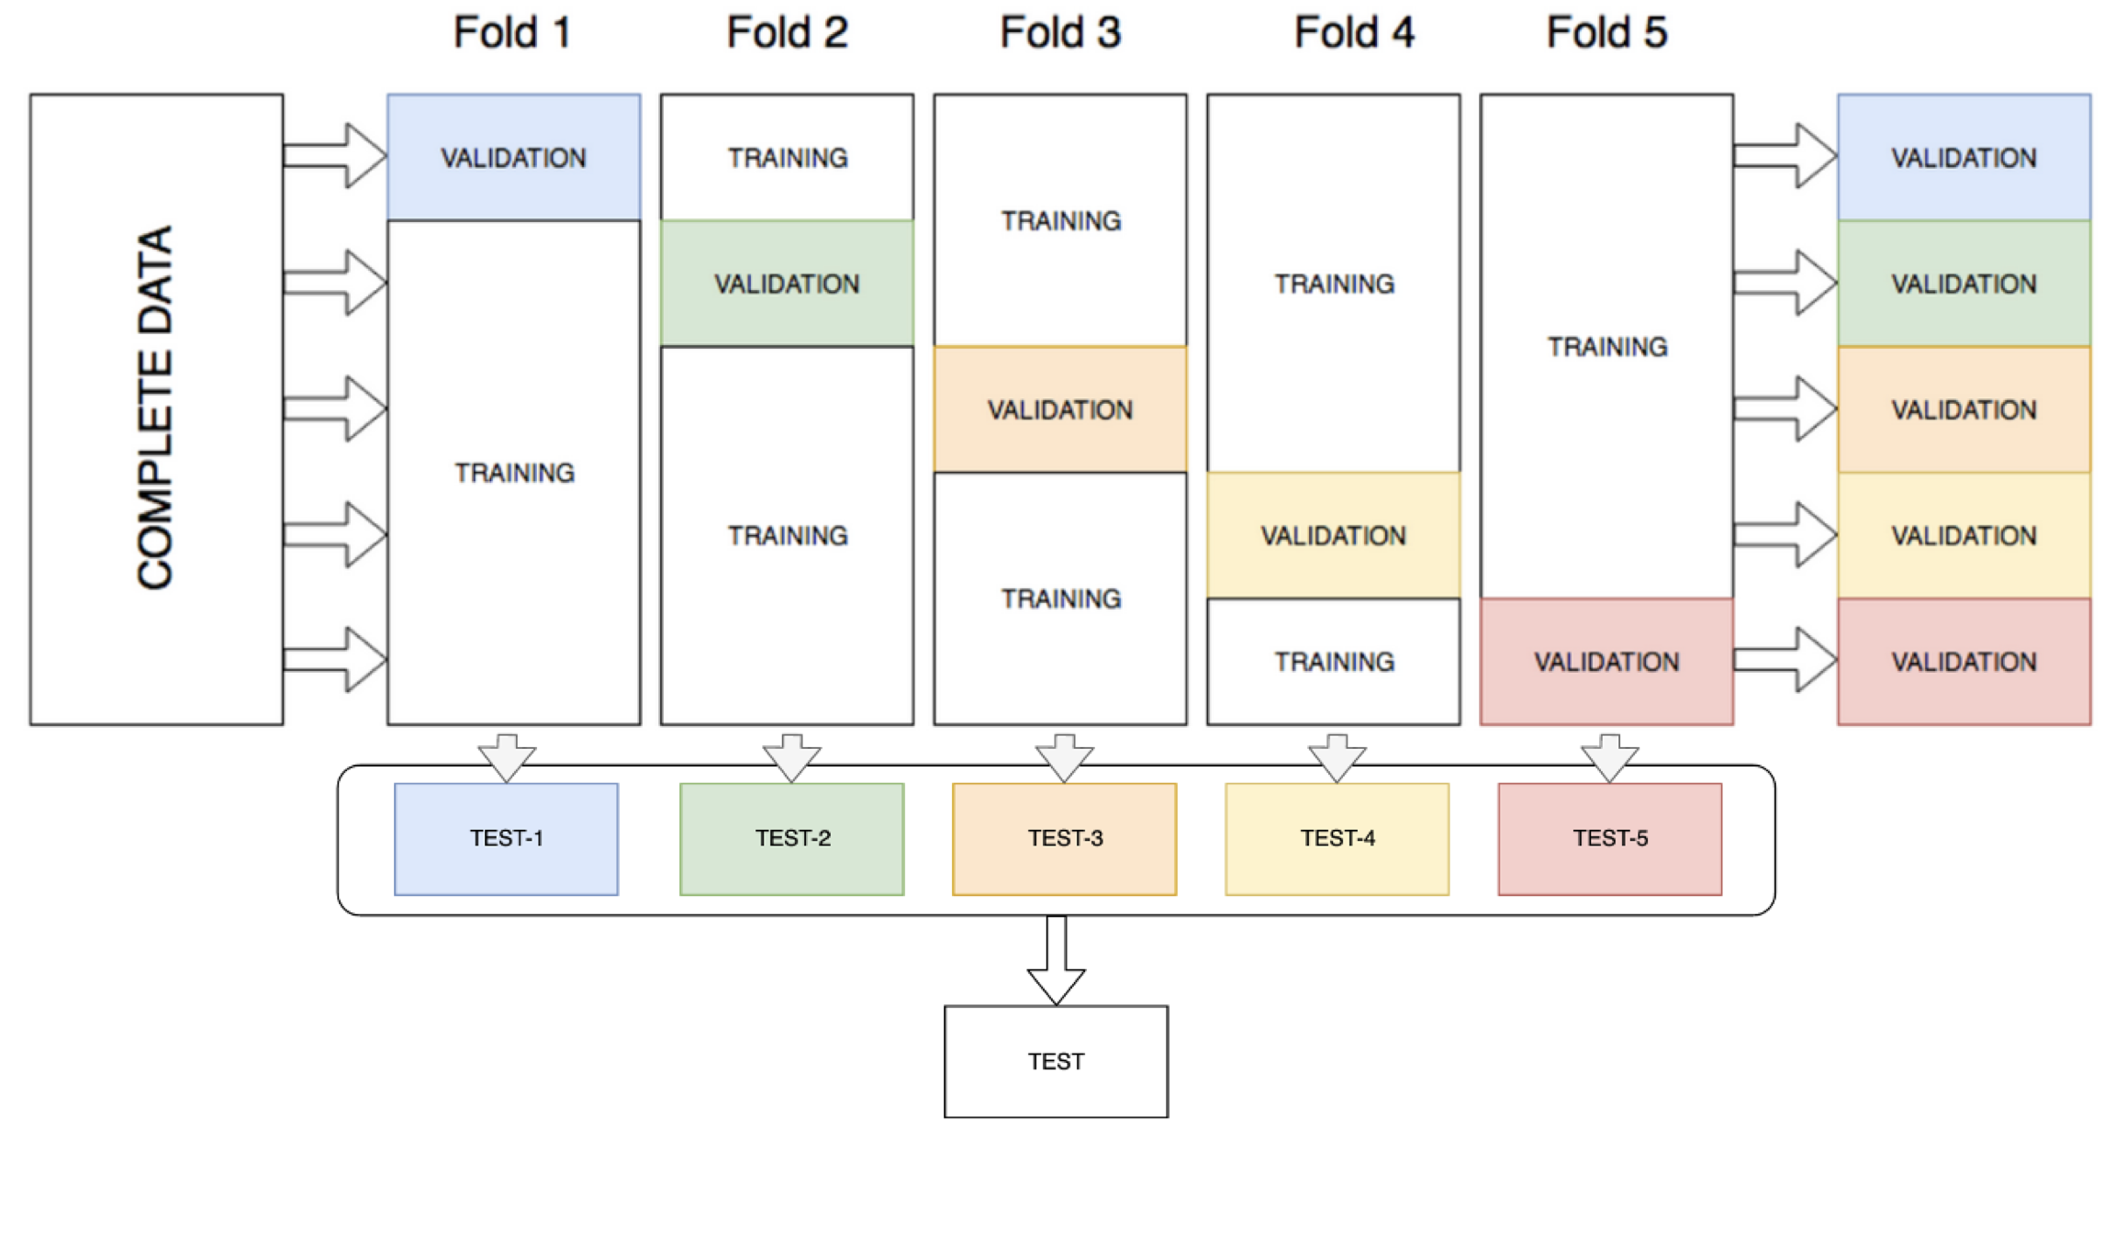
Bagging
Train k different copies of each model with a different chunk of data held-out from each.

Slide 34
Multi-Layer Stack Ensembling
Stacker model uses predictions of every base model as extra features
Layer L+1 stacker model uses layer L predictions as extra features
For simplicity: stacker models types = base model types
NOTE: Stacker must be trained with held-out predictions of lower-layer models

Slide 35
AutoGluon: A Year of Rapid Innovation
AutoGluon v0.1: (March 2021)
>70% winrate vs prior releases (0.0.15)
Multi-modal Tabular + Text support
Added FastAI Tabular Neural Network
Added XGBoost
AutoGluon v0.2: (May 2021)
53% winrate vs 0.1
4x faster inference speed
10x less disk usage
Integration with NVIDIA RAPIDS for GPU support
AutoGluon v0.3: (August 2021)
58% winrate vs 0.2
2x-10x faster online inference (<14 ms end-to-end latency)
Multi-modal Tabular + Text + Image support
Integration with PyTorch Image Models (TIMM)
Custom model support

Slide 36
AutoGluon: A Year of Rapid Innovation
AutoGluon v0.4: (March 2022)
63% winrate vs 0.3 & 93% winrate on large datasets
30% faster inference speed
2-3x faster training speed via parallel bagging with Ray
Added ‘infer_limit’ argument
Added automated temperature scaling calibration
Windows Support
Cloud Training & Deployment via SageMaker
AutoGluon v0.5: (June 2022)
2.5x faster inference speed
Added Time Series Support
Added Multimodal Transformer Support

Slide 37
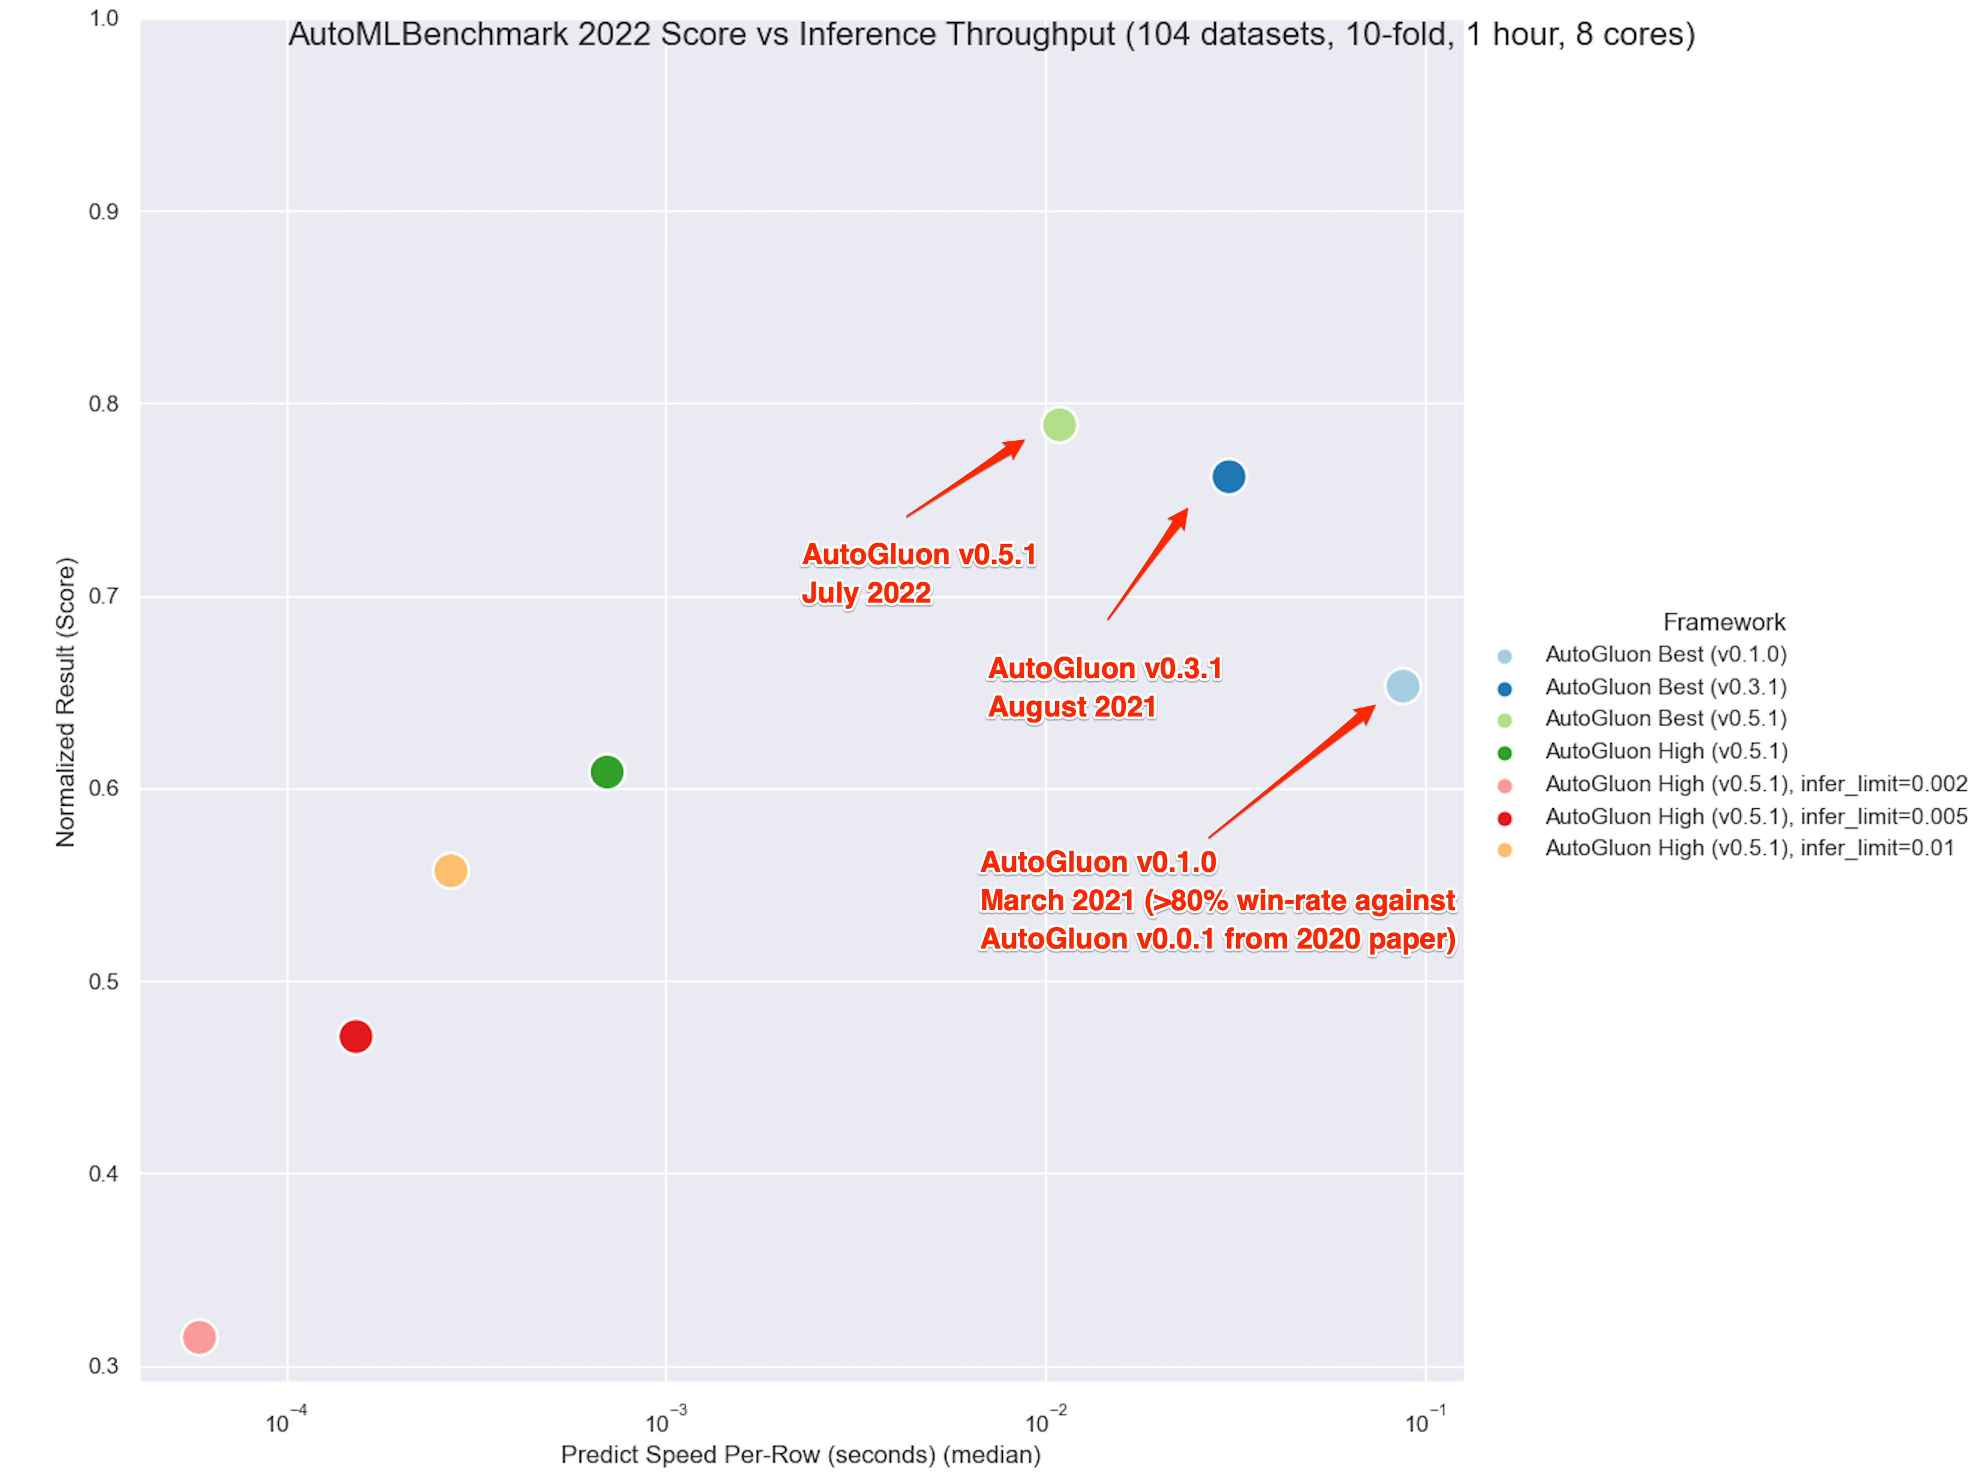
AutoML Improvement by Version

Slide 38
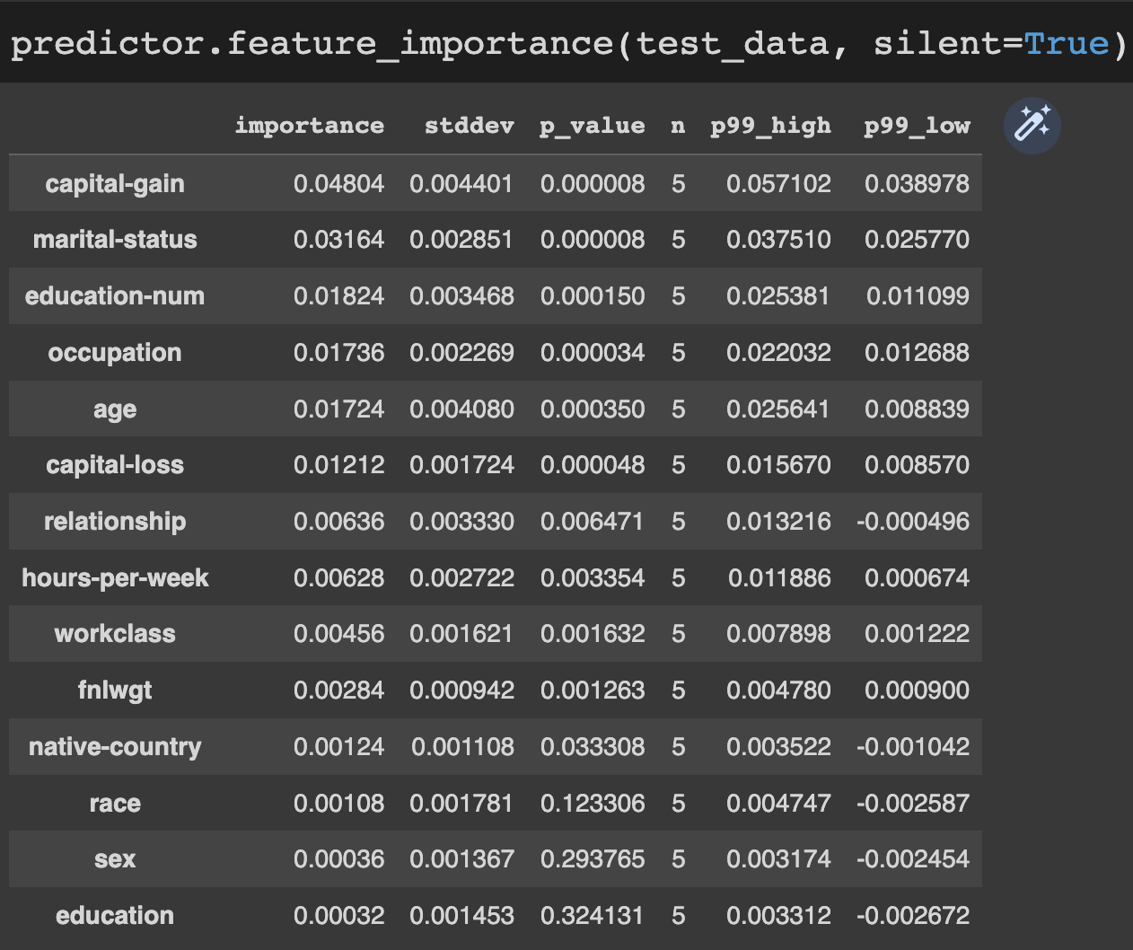
AutoGluon Interpretability
Feature Importance via Permutation Shuffling
Built in kernel SHAP support
imodels package integration

Slide 39
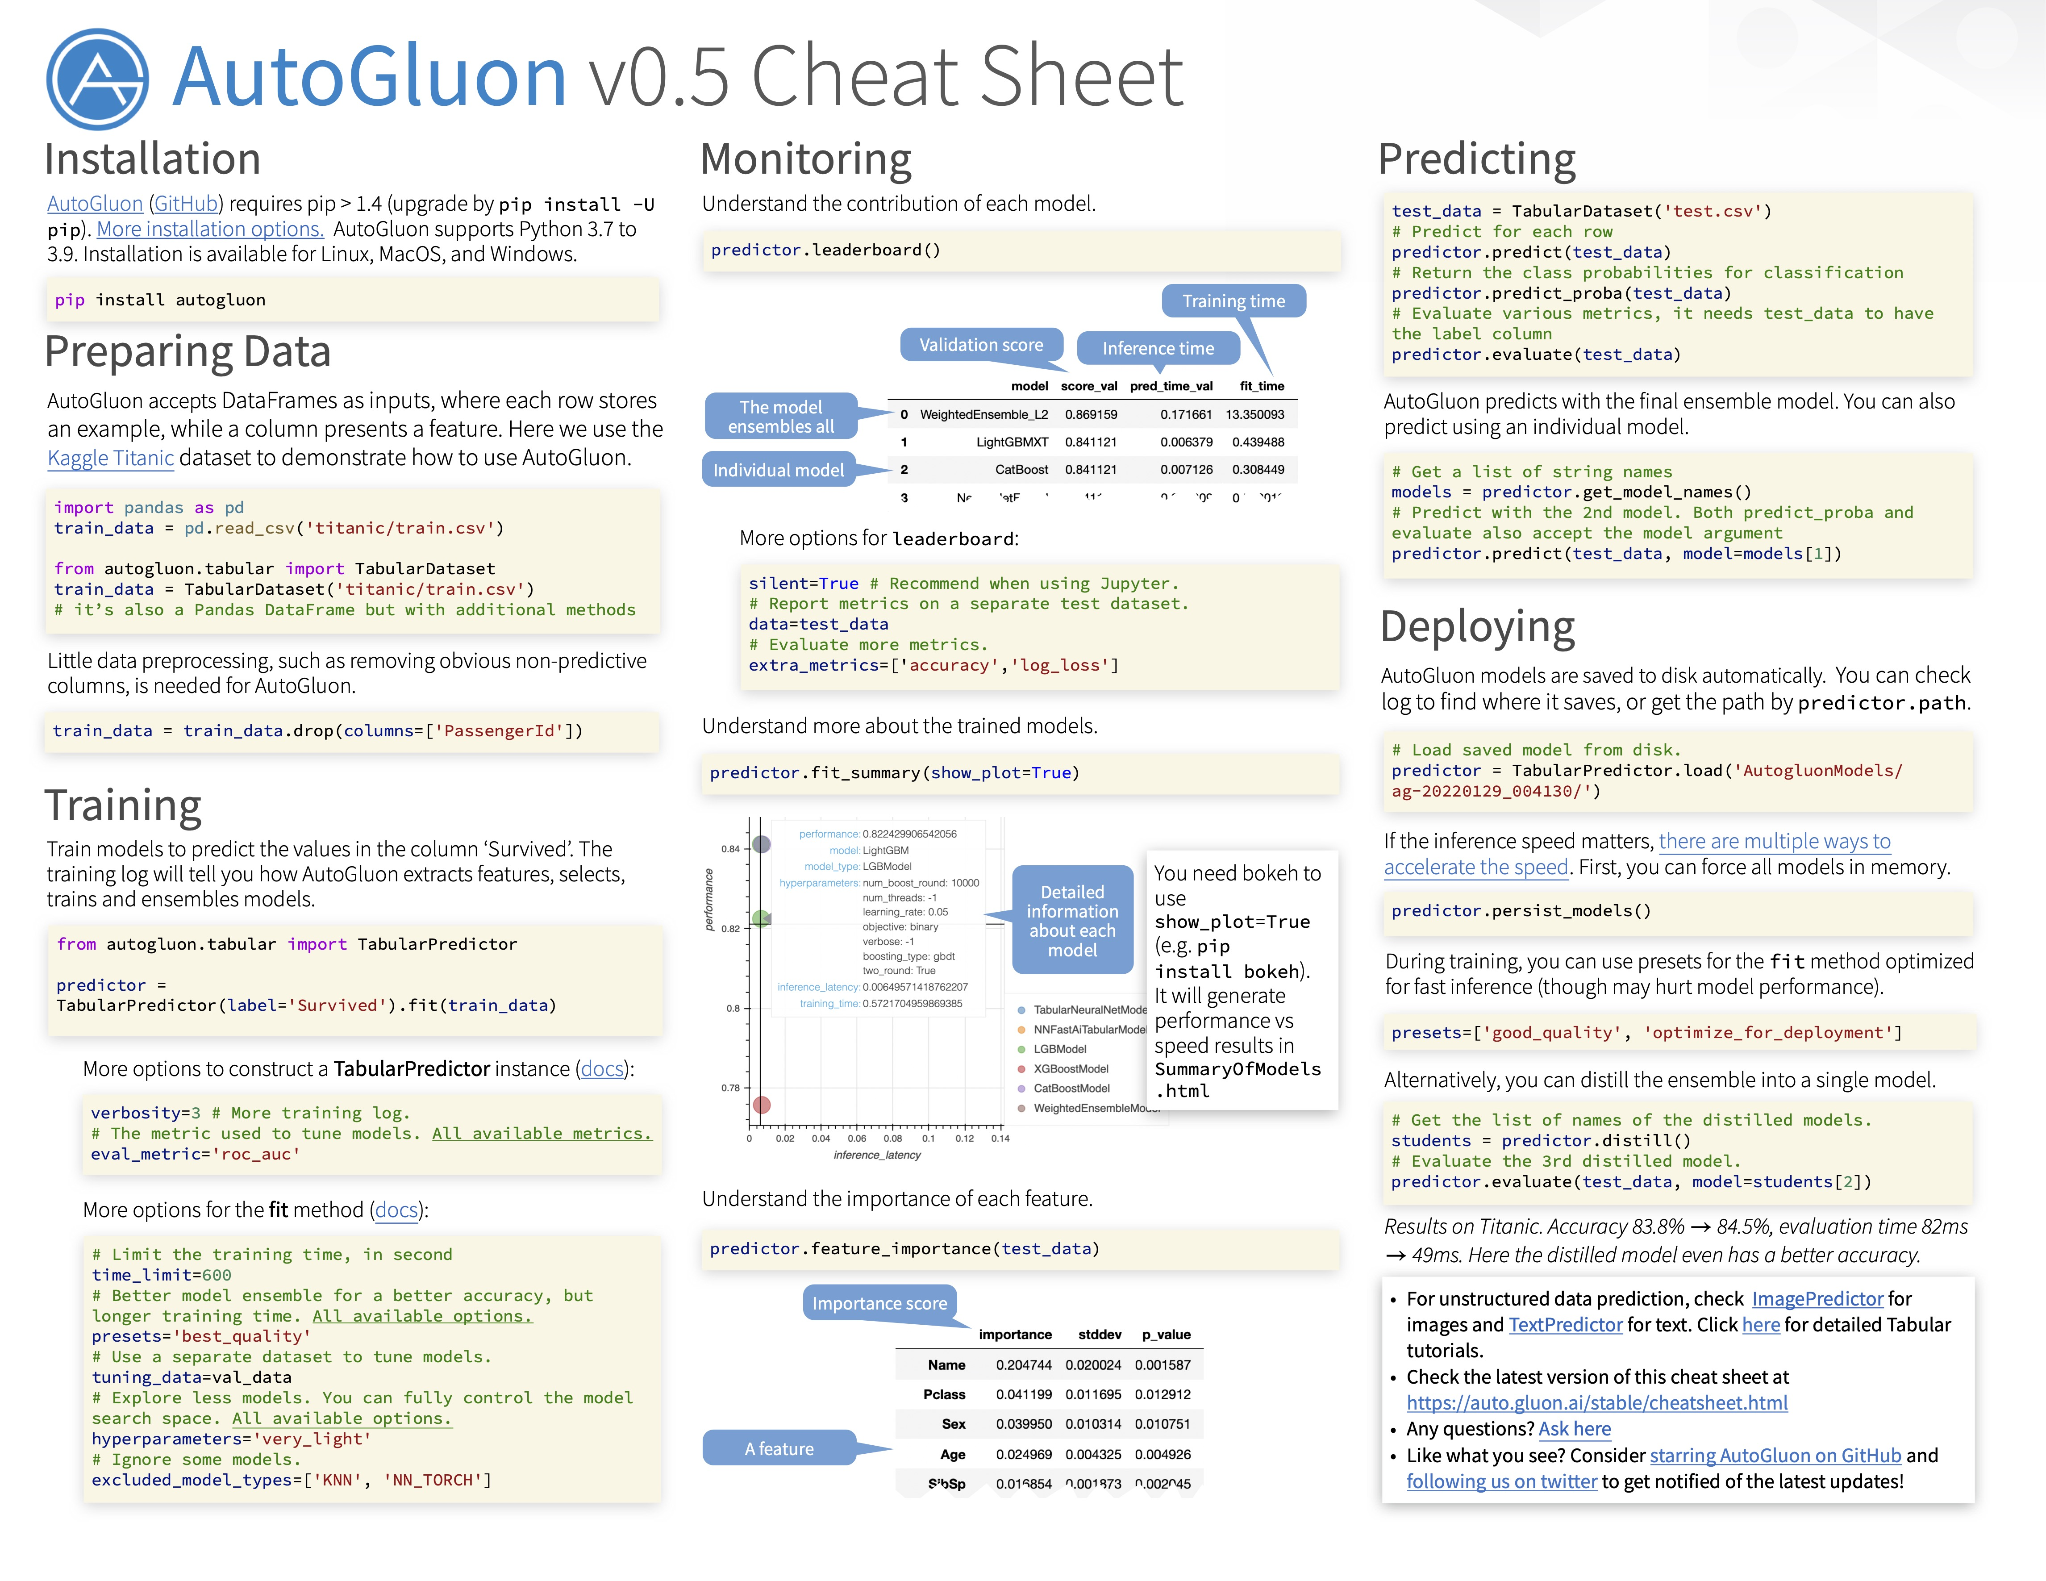

Slide 40
Mini-Q&A (5min)

Slide 41
Part II: Multimodal AutoML

Slide 42
Multimodal Problems: Funding or not?
Text often appear together with other tabular features (categorical & numerical).
Source: Kaggle: Kickstarter Funding

Slide 43
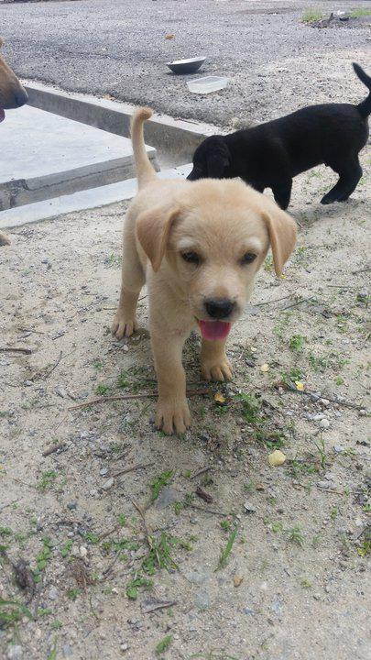
Multimodal Problems: Pet Adoption
Images are also often coupled with text/tabular data.
Pet Image
Tabular Meta-data
Subject Focus | 0
Eyes | 1
Face | 1
Near | 1
Action | 0
Accessory | 0
Group | 1
…
Pawpularity=63. (Range: 0 – 100)
Source: Kaggle: Pet Pawpularity Score

Slide 44
Multimodal Problems: Pet Adoption
Images are also often coupled with text/tabular data.
Pet Image
Text Description
Tabular Features
Yuki was rescued from Bandar Mahkota Cheras. He was wondering around the place …
MaturitySize | 1
FurLength | 3
Vaccinated | 1
…
Adoption speed
Source: Kaggle: Pet Adoption Prediction

Slide 45
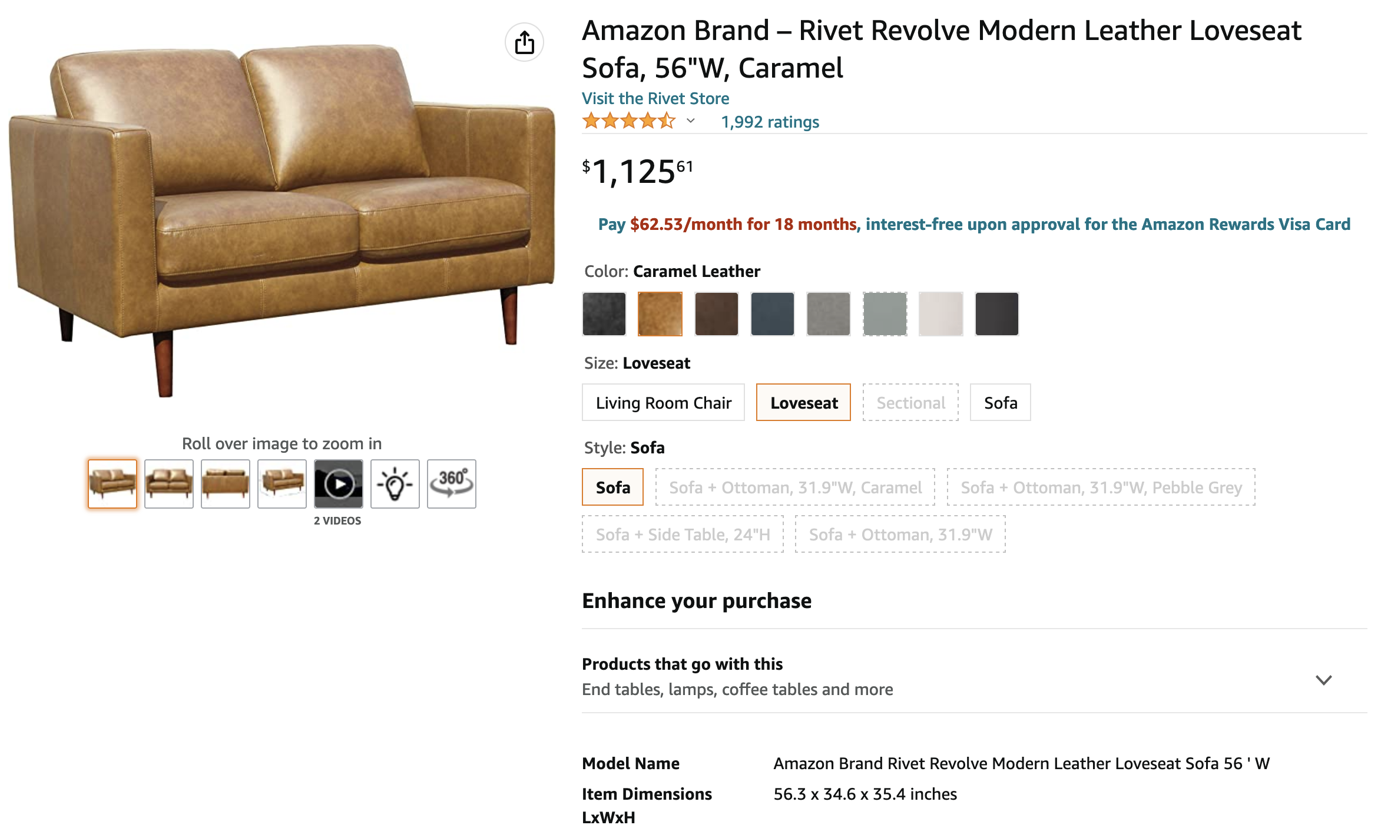

Multimodal Problems: Same Product or Not?
Same product
Images
Title
Price (numerical)
Color (categorical)
Uploaded Image

Slide 46
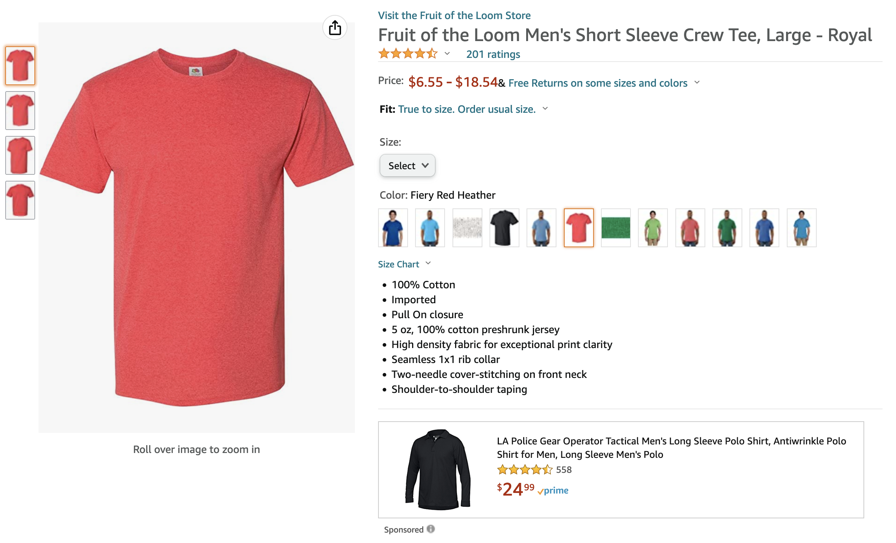
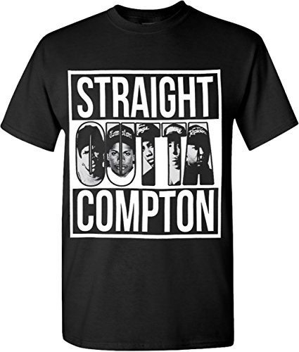
Multimodal Problems: Same Product or Not?
Not the same product
Images
Title
Price (numerical)
Color (categorical)
Uploaded Image

Slide 47






Multimodal AutoML with AutoGluon
predictor.fit(data)
predictor.predict(new_data)
Data that contains image, text, tabular features
Train on any devices
Deployment on local/cloud

Slide 48
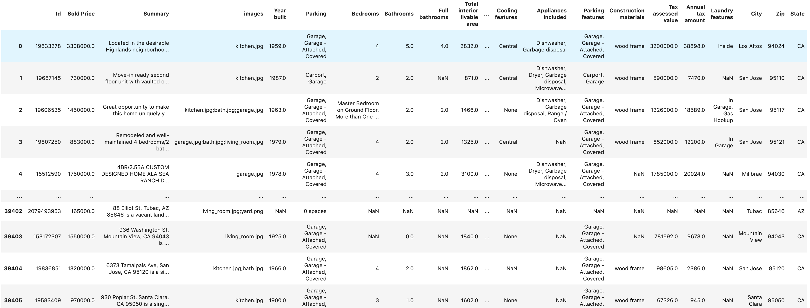

Multimodal DataFrame
Raw text
Bag of images
Example: House price prediction
Label

Slide 49


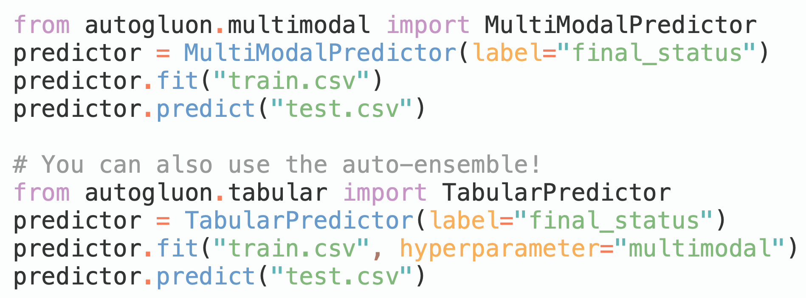



Three-lines of Code
End-to-end fusion of the pretrained models
In addition, it can participate in the auto-ensemble (Part I)
OpenAI/CLIP
See more in https://auto.gluon.ai

Slide 50
Top Performance on Hackathons / Competitions
2nd in “Kaggle: Mercari Price Suggestion”
2380 teams with $100,000 prize money
1st in “MachineHack: Predict The Data Scientists Salary In India”
2nd in “MachineHack: Predict The Price Of Books”
Top 1% in “Kaggle: PetFinder.my - Pawpularity Contest”
3537 teams with $25,000 prize money

Slide 51
What happened within these three lines?
Pretrained Image + Text Models
Multimodal fusion and other training tricks
Automated ensemble (Covered by Part I)

Slide 52
Foundation Models for Image/Text
Foundation Models: Trained on broad data that can be adapted to a wide range of downstream tasks [1].
Text: Pretrained on a diverse collection of corpus
RoBERTa, 2019
ELECTRA, ICLR 2020
T5, JMLR 2020
GPT-3, NeurIPS 2020
DeBERTA-v3, 2021
…
Image: Supervised / Self-supervised learning on ImageNet
EfficientNet-v2, ICML 2021
ViT, ICLR 2021
Swin-V2, CVPR 2022
ConvNeXT, CVPR 2022
BEiT, ICLR 2022
…
Image + Text: Pretrained on image-text pairs
CLIP, ICML 2021
ViLT, ICML 2021
ALBEF, NeurIPS 2021
BLIP, ICML 2022
…
[1] Bommasani, Rishi, et al. "On the opportunities and risks of foundation models." arXiv preprint arXiv:2108.07258 (2021).

Slide 53
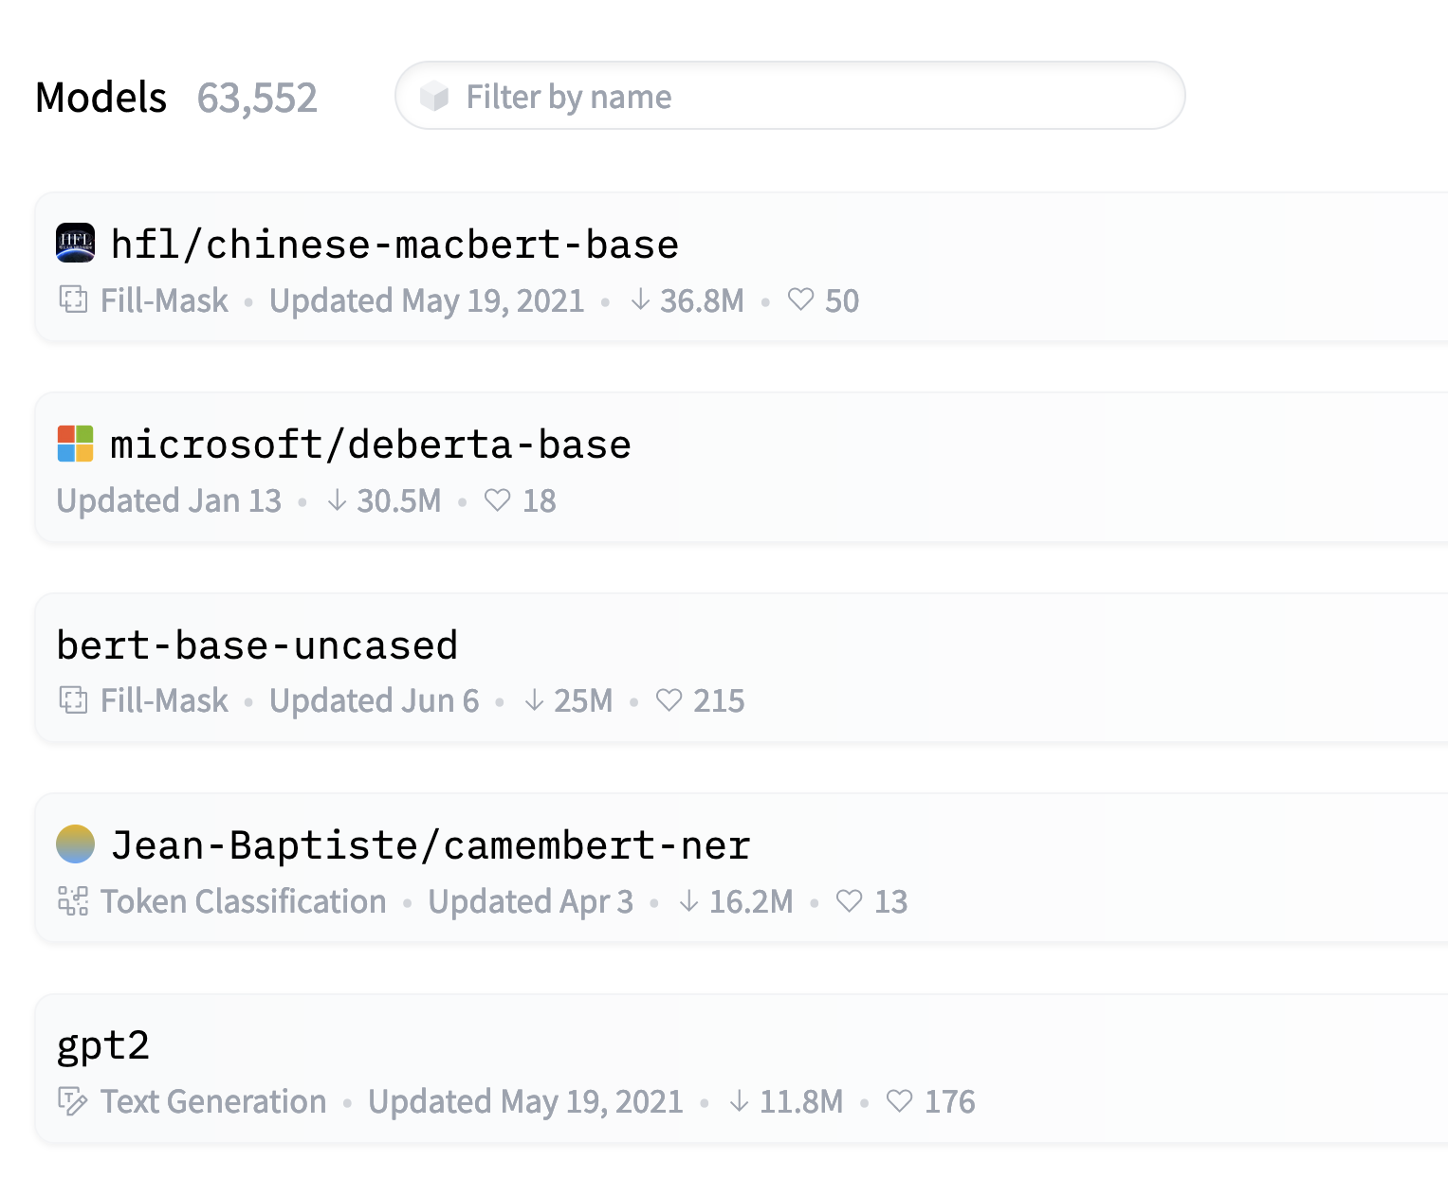
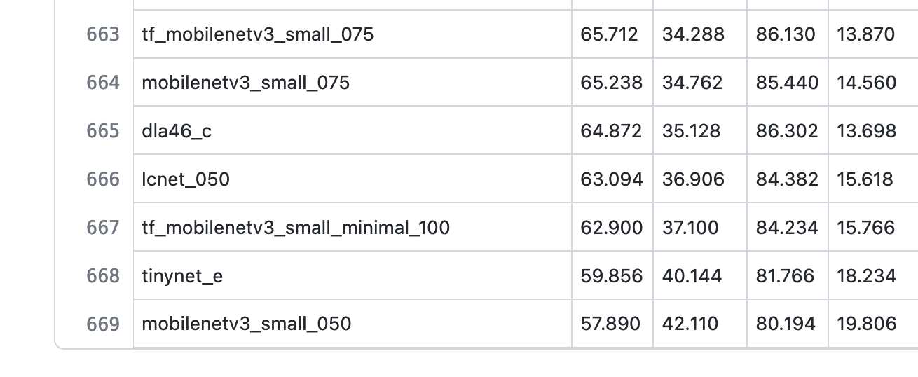
Foundation Models for Image/Text
Tremendous amount of models are publicly available (>60000 in huggingface/transformers, >600 in TIMM)!
However, the idea of “model zoo” is not widely adopted by existing AutoML tools.
Source: https://github.com/rwightman/pytorch-image-models/blob/master/results/results-imagenet.csv. Taken on Aug. 10th, 2022
Source: https://huggingface.co/models. Taken on Aug. 10th, 2022

Slide 54
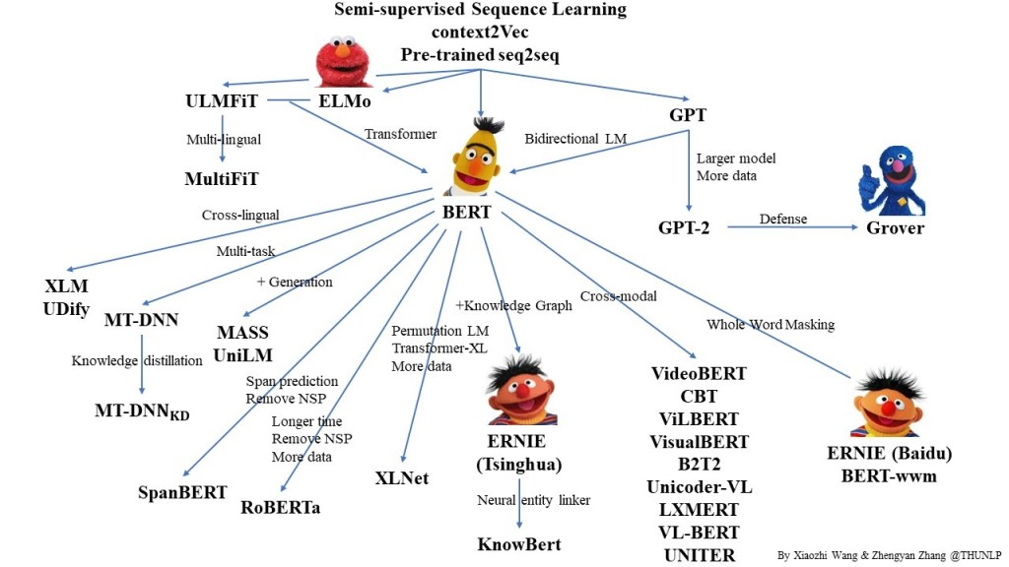
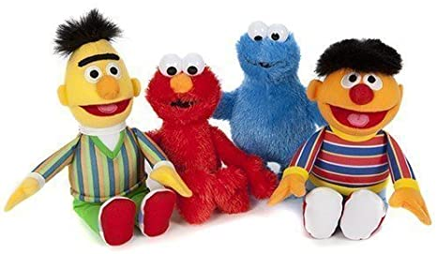

Important Research Questions
Foundation Models
Other Tabular models
+
1. How to use these foundation models?
2. How to combine foundation models with other tabular models (e.g., LightGBM)?

Slide 55
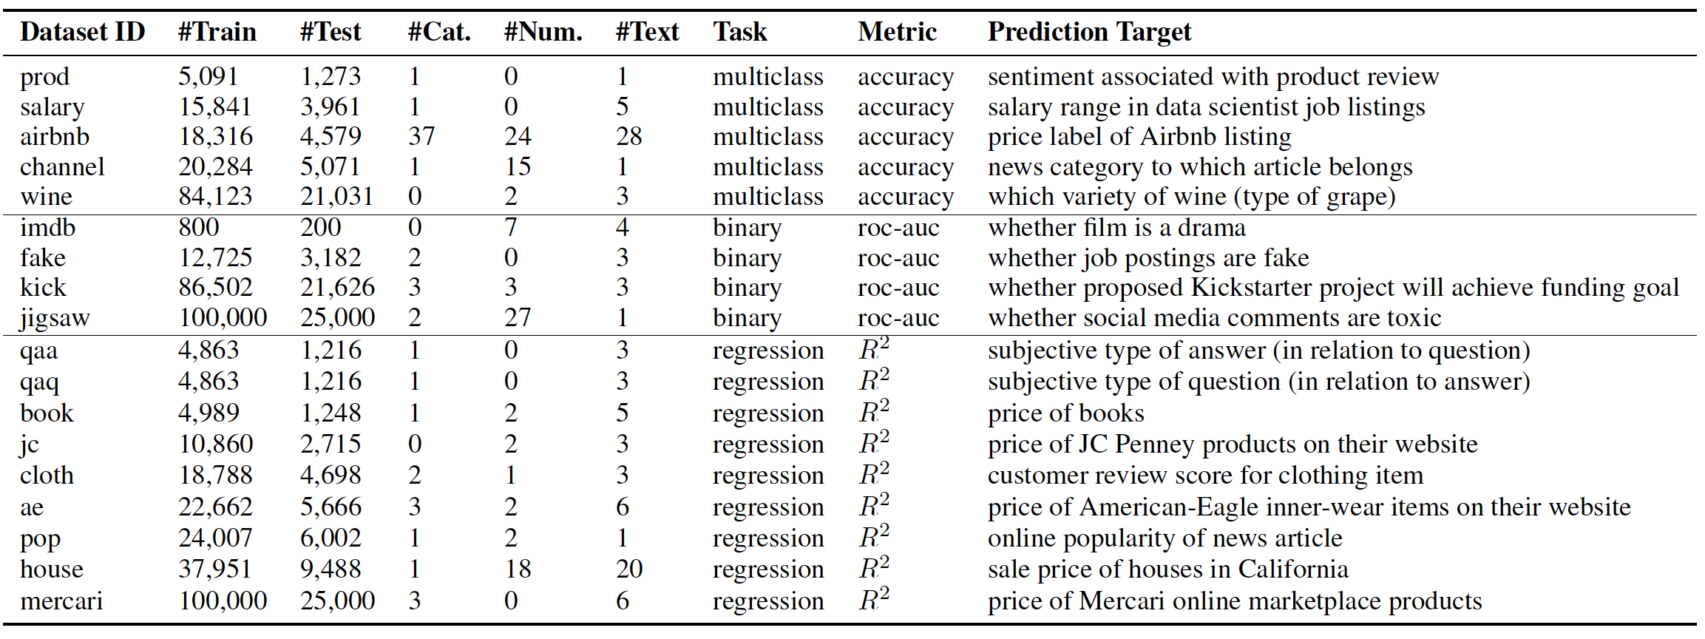
Benchmarking Multimodal AutoML for Tabular Data with Text Fields
18
=
5
+
4
+
9
[1] Shi, Xingjian, et al. "Benchmarking multimodal automl for tabular data with text fields." NeurIPS 2021 Track on Datasets and Benchmarks.
Similar to GLUE benchmark, we use the average as the final score.

Slide 56
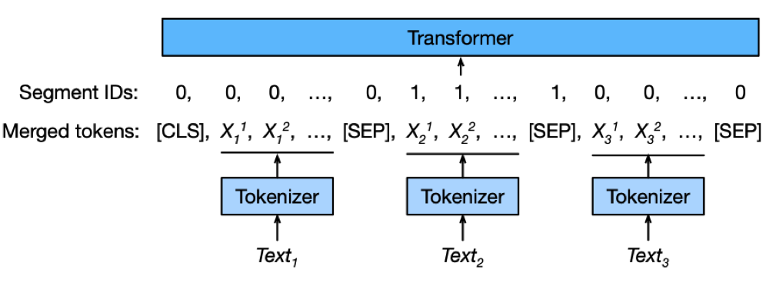
Different Fusion Strategies
Fusion Text / Categorical / Numerical – Multimodal-Net
a) All-Text Fusion
b) Early Fusion
c) Late Fusion
Handling multiple text columns

Slide 57
Aggregating Text & Tabular Models
a) Embedding-as-Feature
b) Weighted-Ensemble
c) Stack-Ensemble

Slide 58
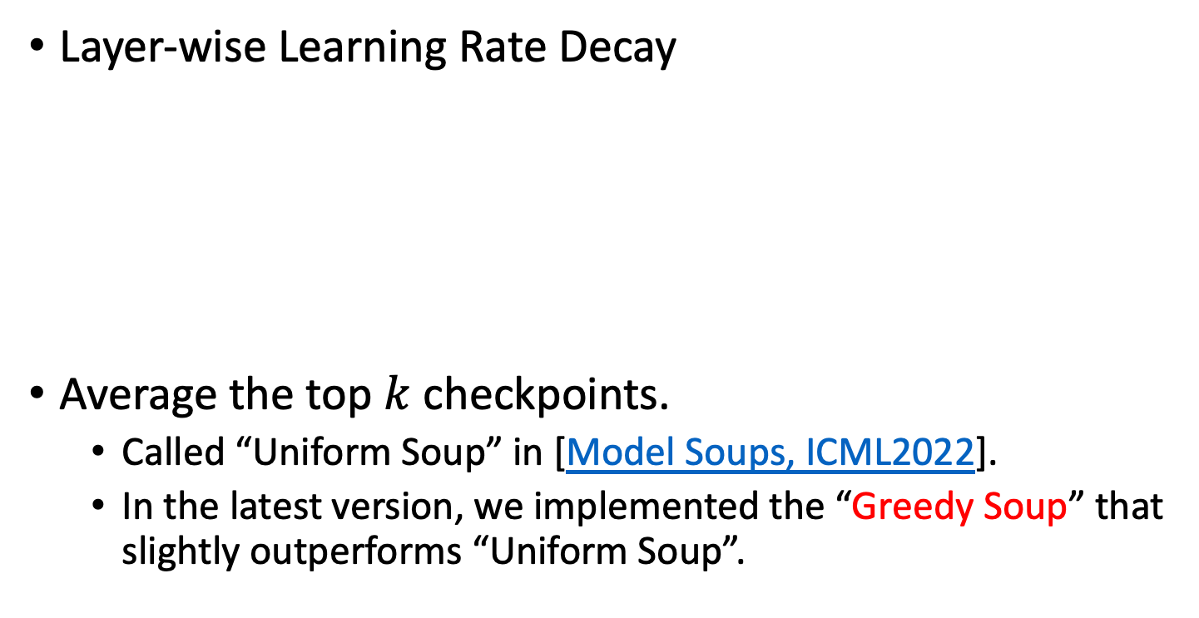
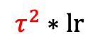
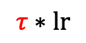
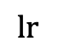
Other Training Tricks
Layer-wise Learning Rate Decay
Average the top $k$ checkpoints.
Called “Uniform Soup” in [Model Soups, ICML2022].
In the latest version, we implemented the “Greedy Soup” that slightly outperforms “Uniform Soup”.
Layer K
$$lr$$
Layer K - 1
$$τ∗lr$$
Layer K - 2
$$τ^{2}∗lr$$

Slide 59
Text Backbone + Training Tricks
Choice: ELECTRA + Exponential decay $τ=0.8$ + Average 3 checkpoints

Slide 60
Determine the Fusion Strategy
Choice: Use Fuse-Late strategy.

Slide 61
How to Combine Pretrained Language Model and Tabular Model
Stack-Ensemble > Weighted-Ensemble >> Text-Embedding / Pre-Embedding

Slide 62
Extend to Image + Text + Tabular
AutoGluon Multimodal (or AutoMM) is a “model zoo” of model zoos.
Image data
Image features
Text data
Text features
Fusion
Output
OpenAI/CLIP
Image+Text features
Tabular data
FT transformer [1]
Tabular features
[1] Gorishniy, Yury, et al. "Revisiting deep learning models for tabular data." NeurIPS 2021

Slide 63

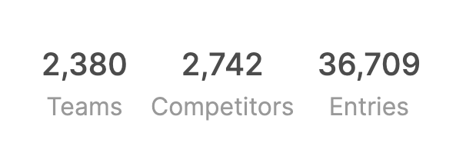

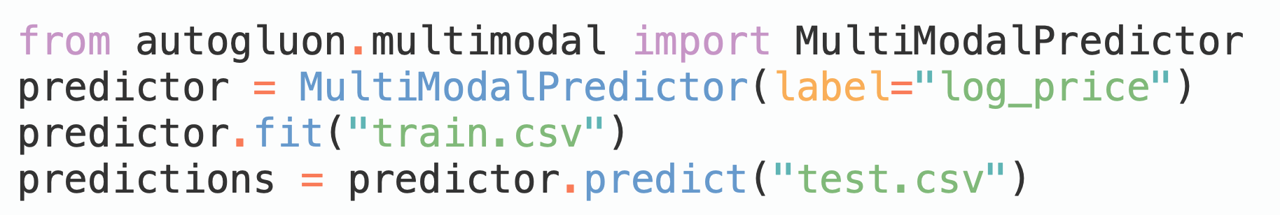
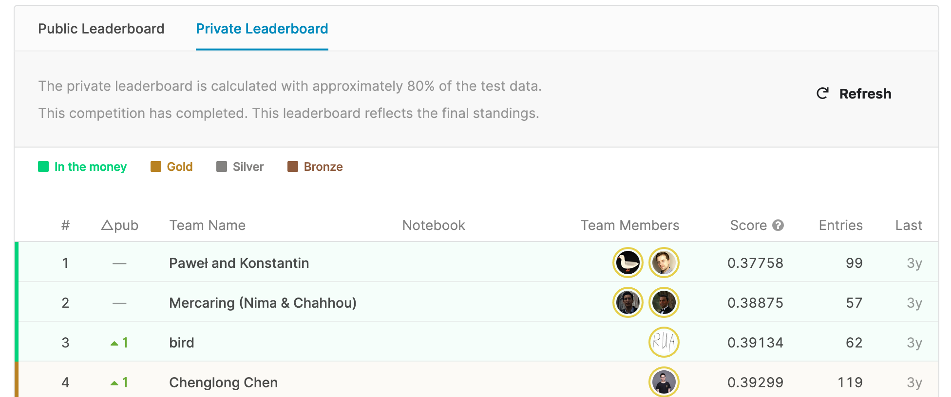
Mercari Price Suggestion Challenge
$100,000 Prize Money
Without ensemble, the model ranks 2nd place (out of 2380 teams)

Slide 64
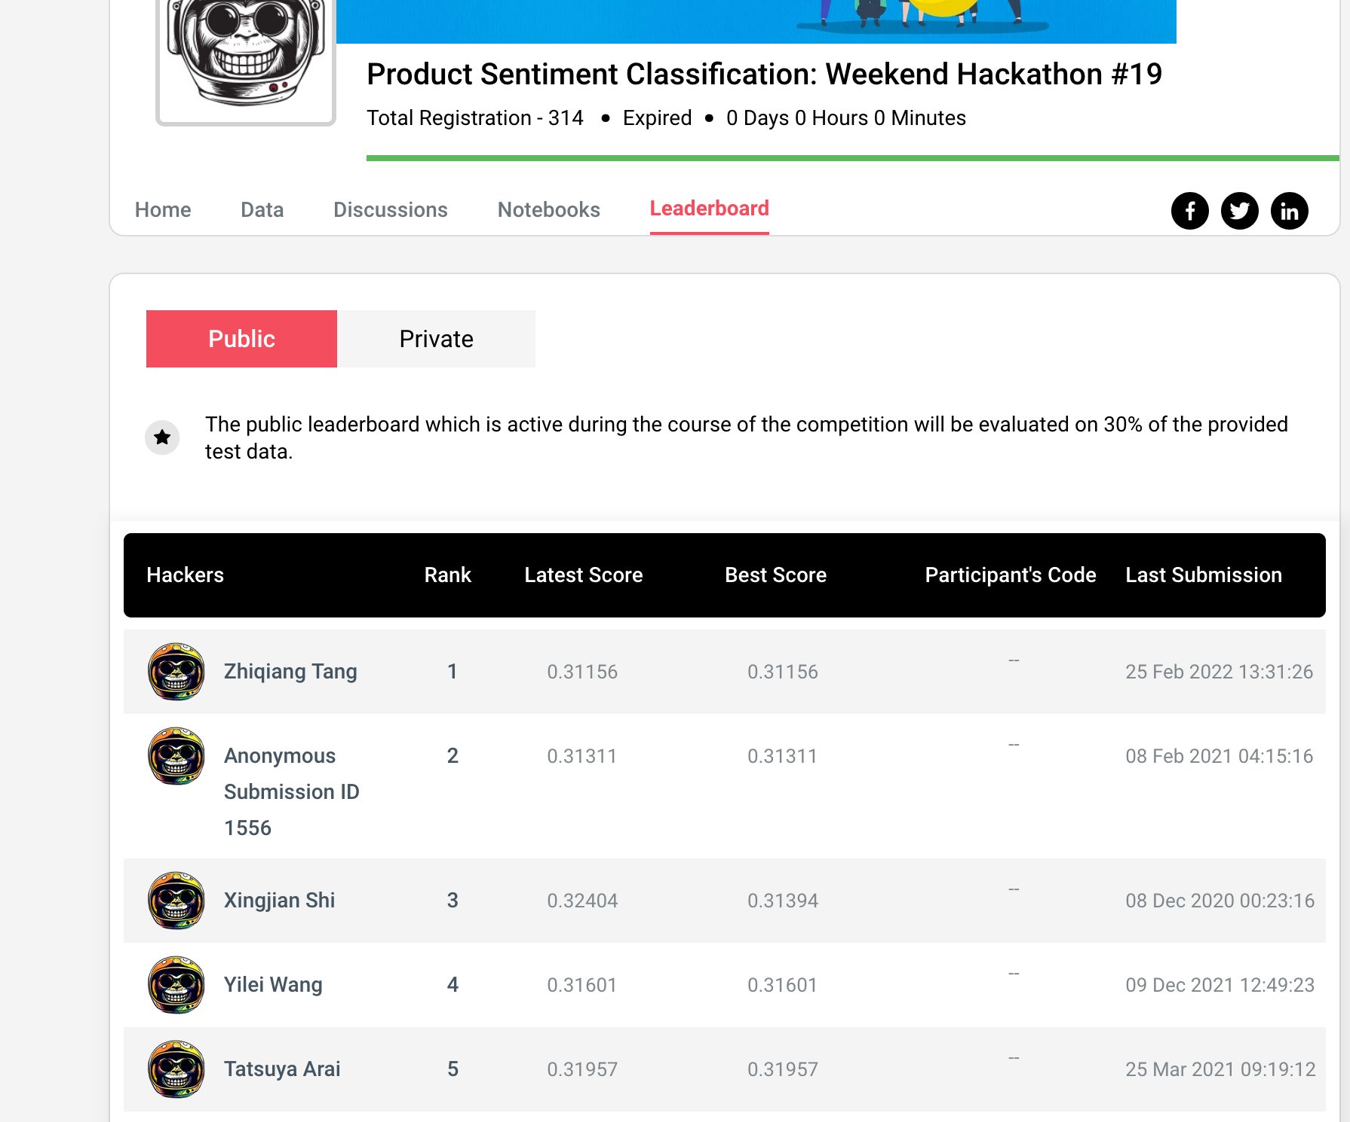
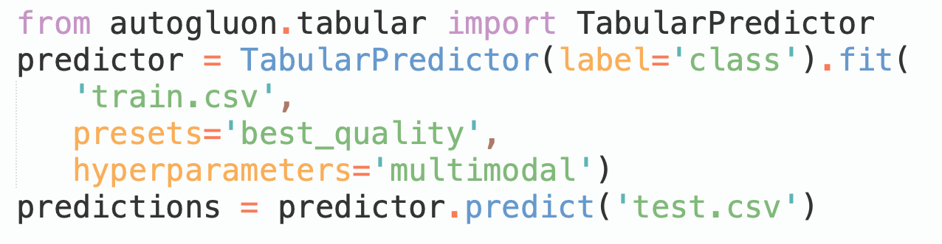
Product Sentiment Classification Competition: 1st Place in 3 lines of code
Fits Stack-Ensemble using both Tabular Models & AutoGluon Multimodal (AutoMM).

Slide 65



Kaggle: PetFinder Pawpularity
The model ranks 20th place (out of 3537 teams), top 1%
Ensemble AutoMM models
vit_large_patch16_384 (fusion)
swin_large_patch4_window12_384 (fusion)
convnext_large_384_in22ft2k
swin_large_patch4_window7_224
Source: https://www.kaggle.com/code/linuxdex/use-autogluon-to-predict-pet-adoption

Slide 66

Top Ranked Kaggle Kernel in Live Competition

Slide 67

More Competition Results

Slide 68

More Competition Results

Slide 69

More Competition Results
California House Price Prediction (Live competition with 172 teams): https://www.kaggle.com/c/california-house-prices/leaderboard

Slide 70
More about AutoGluon Multimodal
Tutorials: https://auto.gluon.ai/dev/tutorials/multimodal/index.html
Check out: auto.gluon.ai & produce accurate models in 5 min!
Contributors welcomed! github.com/awslabs/autogluon

Slide 71
Mini-Q&A (3min)

Slide 72
Part III: AutoML Beyond iid Prediction Time Series, Distributional Shift, and Fairness
Presenter: James Sharpnack
Sr. Applied Scientist, AWS

Slide 73
AutoGluon.TimeSeries
Time Series Forecasting in AutoML

Slide 74


Time Series Forecasting
Time series (TS) for multiple items (panel data)
Want to forecast prediction_length into the future after the forecast time for each TS
Forecasting a target variable (label) potentially with additional covariates
TS is at regular intervals with some freq
Lim et al., 2021

Slide 75

Quantile Forecasts
Point prediction: forecasting a single mean prediction for each look-ahead time
Metrics for evaluating quality:
MASE: mean absolute scaled error
MAPE: mean absolute percentage error
sMAPE: symmetric MAPE
Quantile prediction: provide quantiles for the distribution of each look-ahead day
Coverage: the percent of samples falling in a quantile range (e.g. 10% to 90%) should approximate the range’s coverage (80%)
Mean weighted quantile loss
cdc.gov

Slide 76
Validation and Backtesting
Temporal train-test split
Set past time (at least prediction_length in the past) as the forecast time (t)
Train on data prior to t
Forecast for times after t
Calculate eval metrics using time after t
Do 1-4 for more forecast times (multi-window split)
Challenges
Validation scores computed out of time, do not generalize as well as exchangeable data.
Due to autocorrelation, the validations scores may not concentrate around their expectation, and thus can be noisy.
In tabular data: training is expensive, inference (prediction) is cheap. In time series: both are expensive and simpler models “refit” at validation time.

Slide 77






Built on AutoGluon’s familiar API
Model zoo including ETS, ARIMA, Prophet, and many GluonTS models
GluonTS
pmdarima
tbats
TimeSeries
Hyperparameter Optimization with Ray Tune or plain random search

Slide 78
Available Models
Monte Carlo sampling for one step ahead quantile forecasters vs. Seq2Seq models predict entire trajectories into the future
DeepAR (Salinas, et al. 2020): autoregressive RNN model
MQCNN, MQRNN (Wen, et al. 2017): seq-to-seq quantile regression model with convolutional or recurrent neural net
Simple feed forward neural net
Prophet (Taylor and Letham, 2018): additive model with parametric seasonal, trend, holidays components
AutoARIMA (sktime): automatically select AR lag, MA window length, degree of differencing
AutoETS (sktime): automatically select the error, trend, seasonality parameters
TBATS (sktime)
Greedy ensembles…

Slide 79
Introducing AutoGluon-TimeSeries
Now available in AutoGluon v0.5: AutoML for time series forecasting, built on AutoGluon and GluonTS in Python.
Flexible hyperparameter optimization, model selection, and ensembles for GluonTS models and beyond!

Slide 80

Training a wide array of forecasting models is as simple as a few lines of code.
Train with presets–a collection of predetermined models and hyperparameter settings.
Limit training time

Slide 81
Q&A

